Slide 1
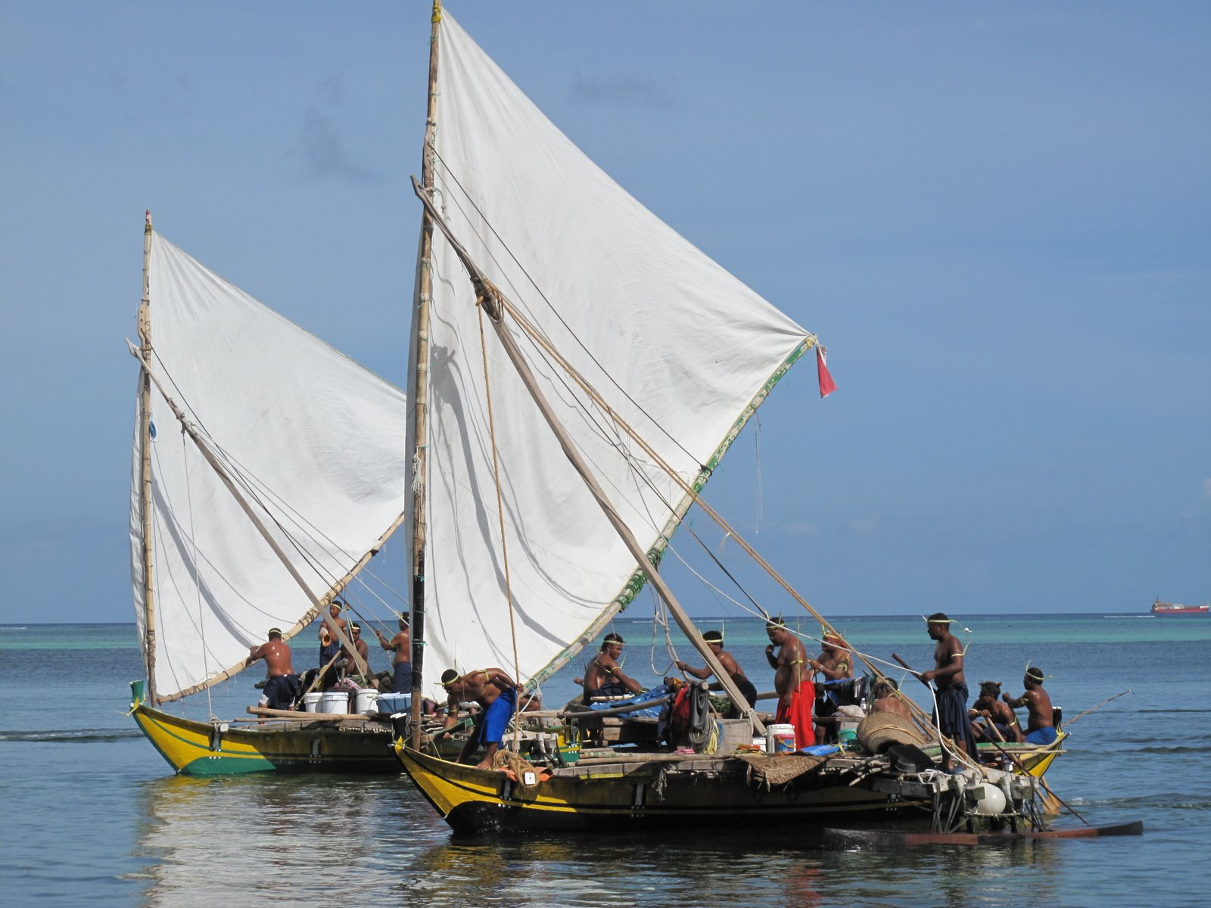
Commonwealth of the Northern Mariana Islands: Historical Impacts and Community Resilience to Natural Changes
Governor Benigno R. Fitial, Commonwealth of the Northern Mariana Islands
Pacific Islands Panel First Stewards: Coastal Peoples Address Climate Change
July 17-20, 2012
Smithsonian National Museum of the American Indian, Washington D.C.
Notes:
Tirrow from the Commonwealth of the Northern Mariana Islands, I am Benigno R. Fitial, Governor of the CNMI, and also a descendant of the Refaluwasch. My people left Satawal in Yap and settled in Saipan thousands of years ago. We are known for our skills in the art of traditional navigation. We utilized the stars, ocean currents and winds to make our voyages through the Pacific Ocean to settle on Saipan after a changing climate and typhoons nearly destroyed most of our island.

Slide 2
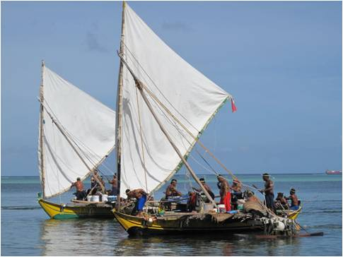
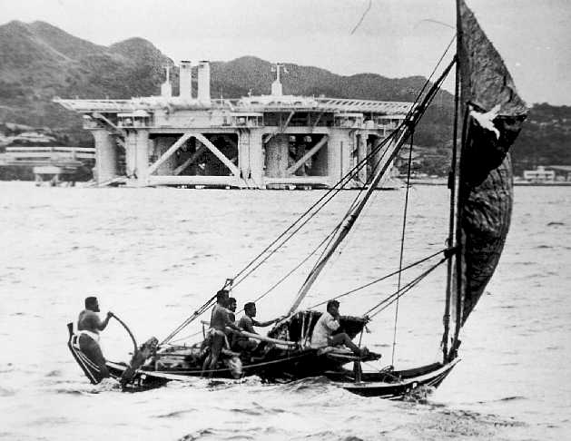
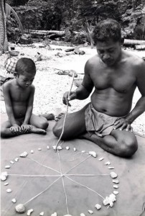
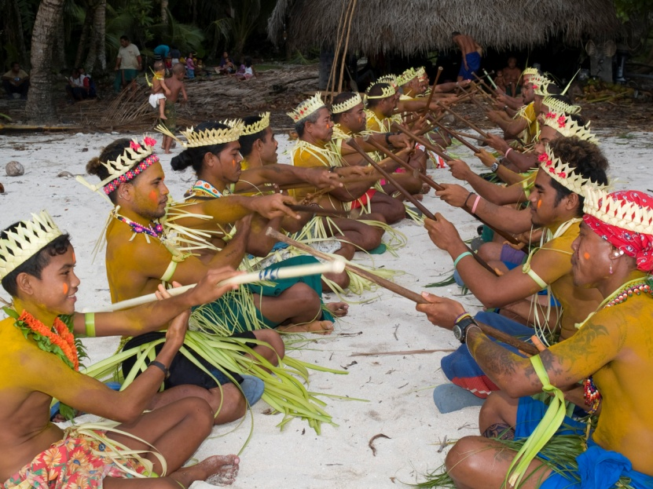
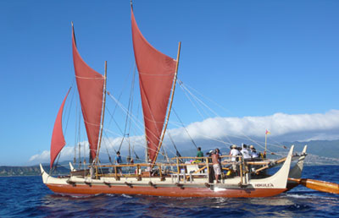
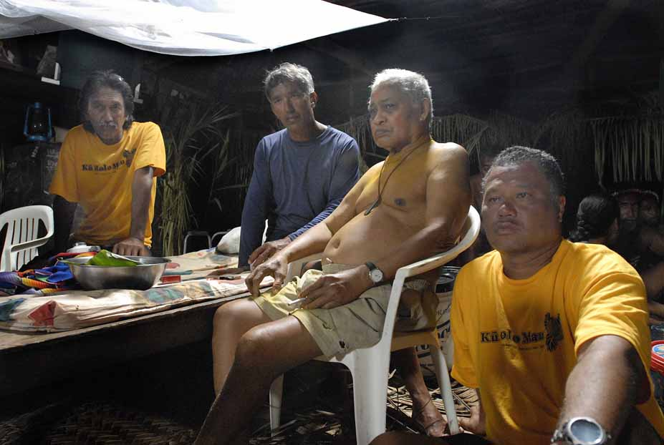
A Seafaring People
Notes:
The seafaring people of Micronesia continue their sailing traditions to visit family and friends or feed their people. These islands are small, some too small that you can see the ocean around the island from anywhere on the island. Our people traveled across the ocean without modern instruments to guide them in reaching their destinations. These trips are perilous and our people who take them very brave. My late cousin, Mao Pialug, was a well known navigator who was the first to share our seafaring knowledge with the outside world. His, and our, legacy lives on through the reintroduction of traditional navigation to our brothers and sisters in Hawaii. His lessons reminded us that our tradition and culture hold the key to our survival.

Slide 3
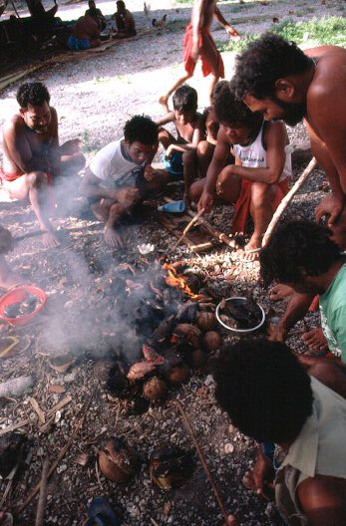
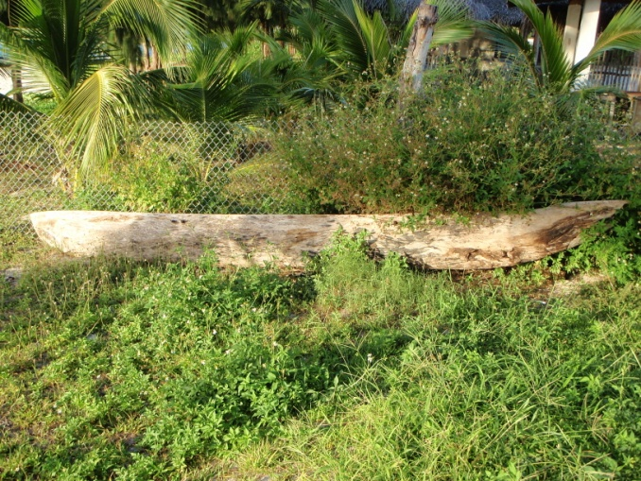
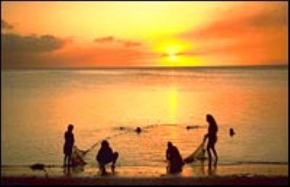
Historical Adaptations
Use everything you can
Manage your resources
Work together!
Notes:
But leaving our islands is a last resort. To survive, our people have historically utilized management strategies and adapted to changes in the environment as needed. One of the adaptations was to learn to use every part of a fish or plant for maximum benefit. Rules were adopted on the harvest of resources that were appropriate to the current situation, such as changing natural conditions (drought, extreme rainfall, etc) or man-made conditions (increasing population, conflict, etc). The greatest adaptation that our people have made has been learning to work together, to share, and to cooperate. These approaches were necessary to overcome any historical impact. It also had an added benefit of bringing our people and our community, spread throughout Yap and the Mariana Islands, closer together.

Slide 4
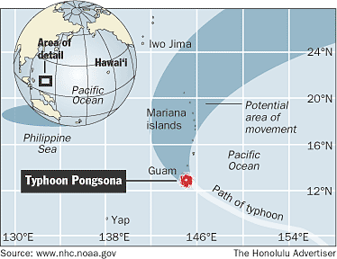
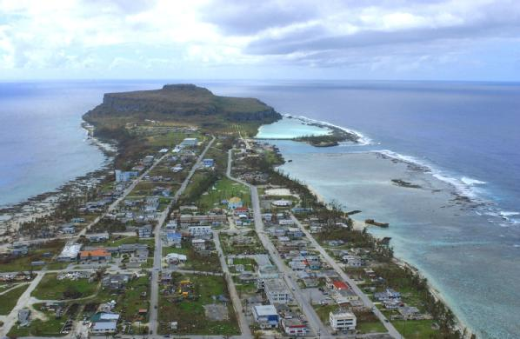
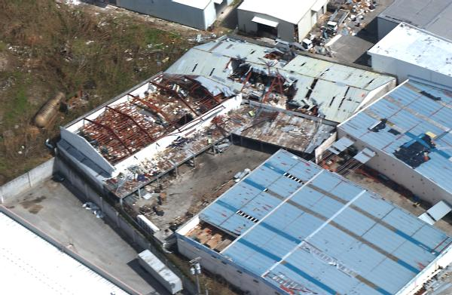
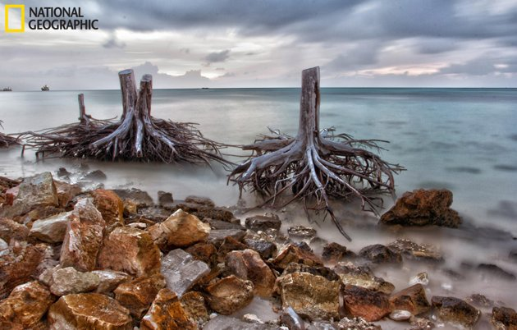
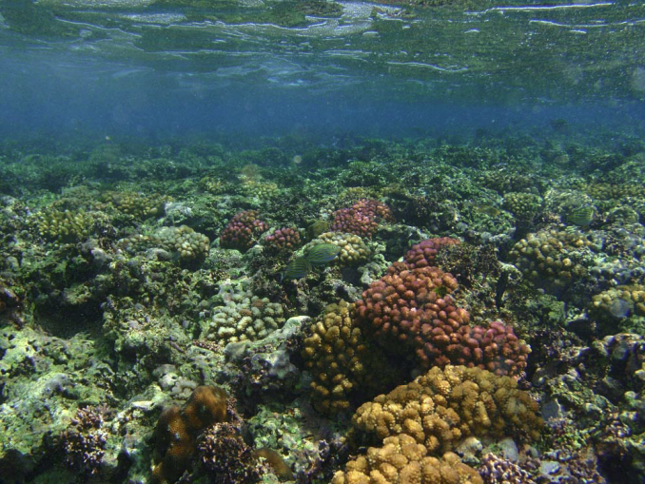
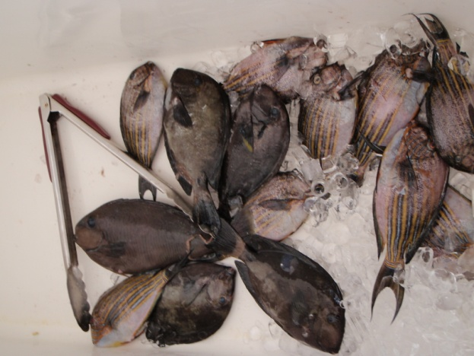
Changing Islands
Notes:
As a group of islands surrounded by water and far from large land masses, the CNMI keeps informed about the changing world environment as a small change in climate has a greater impact on our small islands. For centuries, the CNMI has been battered by natural disasters, especially typhoons and droughts. These are becoming more frequent; destroy most of our shoreline and areas used for traditional practices. More importantly, our people depend on our fragile coral reefs for protection from the waves and serves as our main source of traditional and cultural foods. The corals are also susceptible to these disasters as well as changes to water temperature, salinity and turbidity. In essence, if we lose our corals, we lose our traditions and we lose our culture.

Slide 5
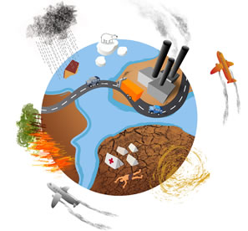
An Ever Changing Climate
Notes:
We are here today because scientists and managers around the world are telling us about the effects of climate change on our environment. They also tell us that increased carbon in the atmosphere is leading to global warming, that in turn, is causing more carbon to be absorbed by our oceans and affecting our coral reefs. But we know this! Not because we have done the research or published articles, but because we have experienced the changing climate for millennia. We know that changes in rainfall patterns and storm seasonality can affect a fish’s cue to complete its life cycle. We also know that plants are dependent upon cues from the weather to flower and fruit, all from observation passed through the generations.
We in the CNMI, along with the natives elsewhere in the Pacific, have lived through these types of changes throughout history and have adapted and passed on the information through our oral histories about the dangers of the changing climate. Our traditional knowledge has led to the development of resiliency in our people, allowing us to change and adapt to the environment and ensure the survivability of our people.

Slide 6
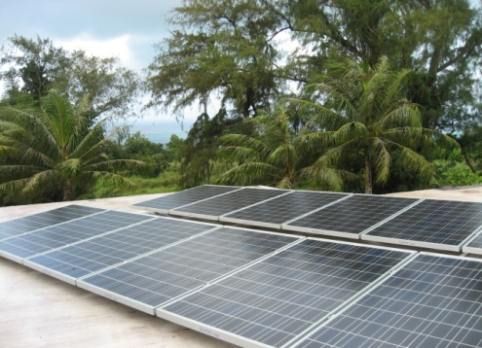
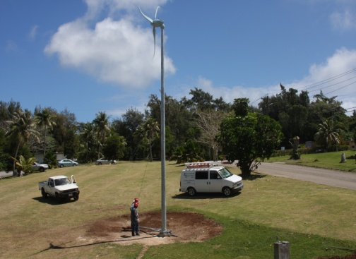
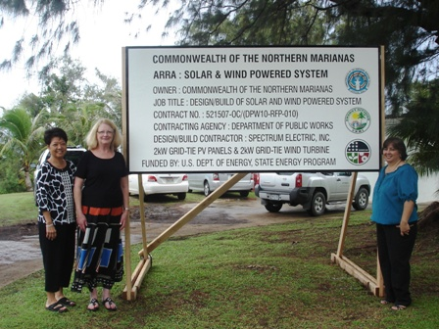
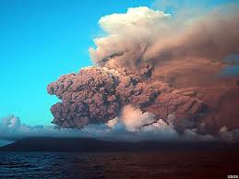
Adapting With the Times
Alternative Energy
Notes:
The CNMI continues to develop resiliency within its community by implementing policies that provide relief to our people from these impacts. We are looking at alternative energy as a source to mitigate some impacts of climate change. Pilot projects are generating electricity through wind turbines and harnessing energy from the sun. Our islands are volcanic so we are also exploring geothermal energy. Several locations on our main island have been tested and found to have the necessary heat to generate power.

Slide 7
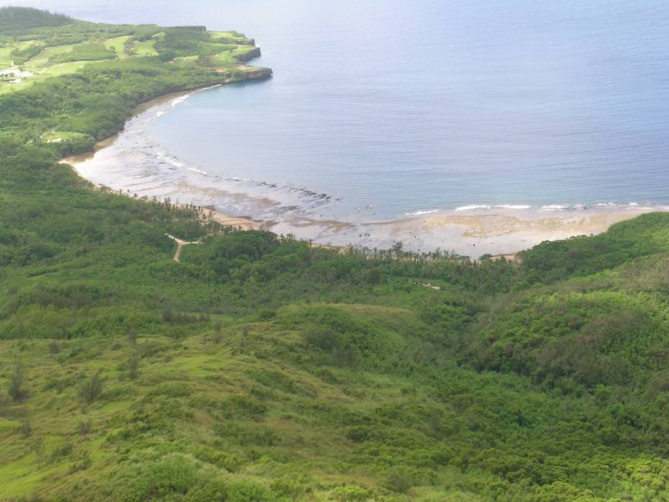
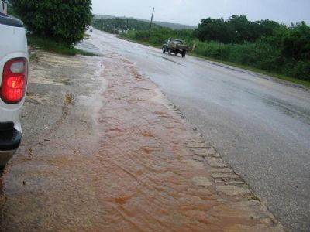
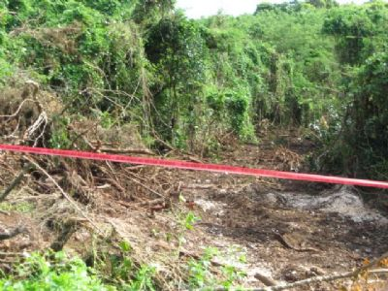
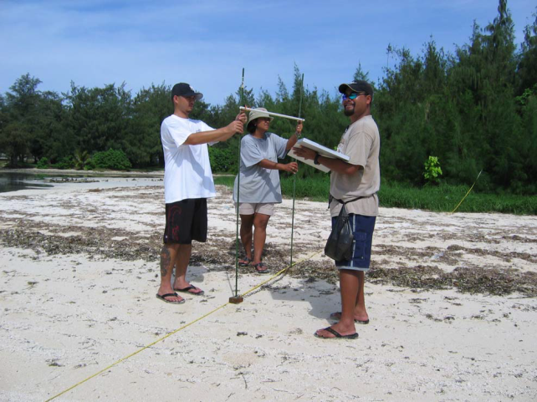
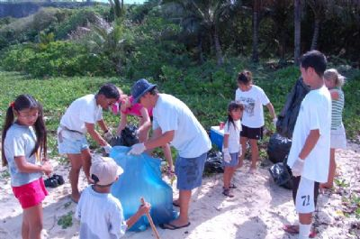
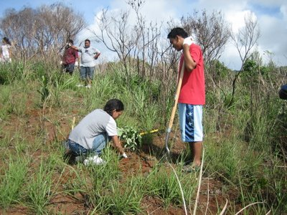
Doing What We Can Now!
Don’t Compound the Issue!
Notes:
Projects being conducted by our agencies are also addressing a changing climate, as climate change won’t wait for funding assistance or for us to develop plans. Although we cannot control these large global events such as typhoons or droughts, we CAN control the man-made impacts on our resources. Our local strategies to help manage our coral reefs include reducing sediment, nutrients and other land-based sources of pollution through re-vegetation projects that stabilize soils; minimizing the impact of tourism and recreational activities through education and outreach and clean-up activities; and regulating fishing practices that are harmful to the environment. Other of our projects acknowledge that we can’t control the rainfall and runoff, so the projects are implementing road and drainage improvements to make sure that the fresh water continues to replenish the land and nearshore ecosystems, decrease erosion and support coral reef ecosystem health. These are things we CAN control now to ensure that any impacts we feel from a changing climate aren’t compounded by our current actions.

Slide 8
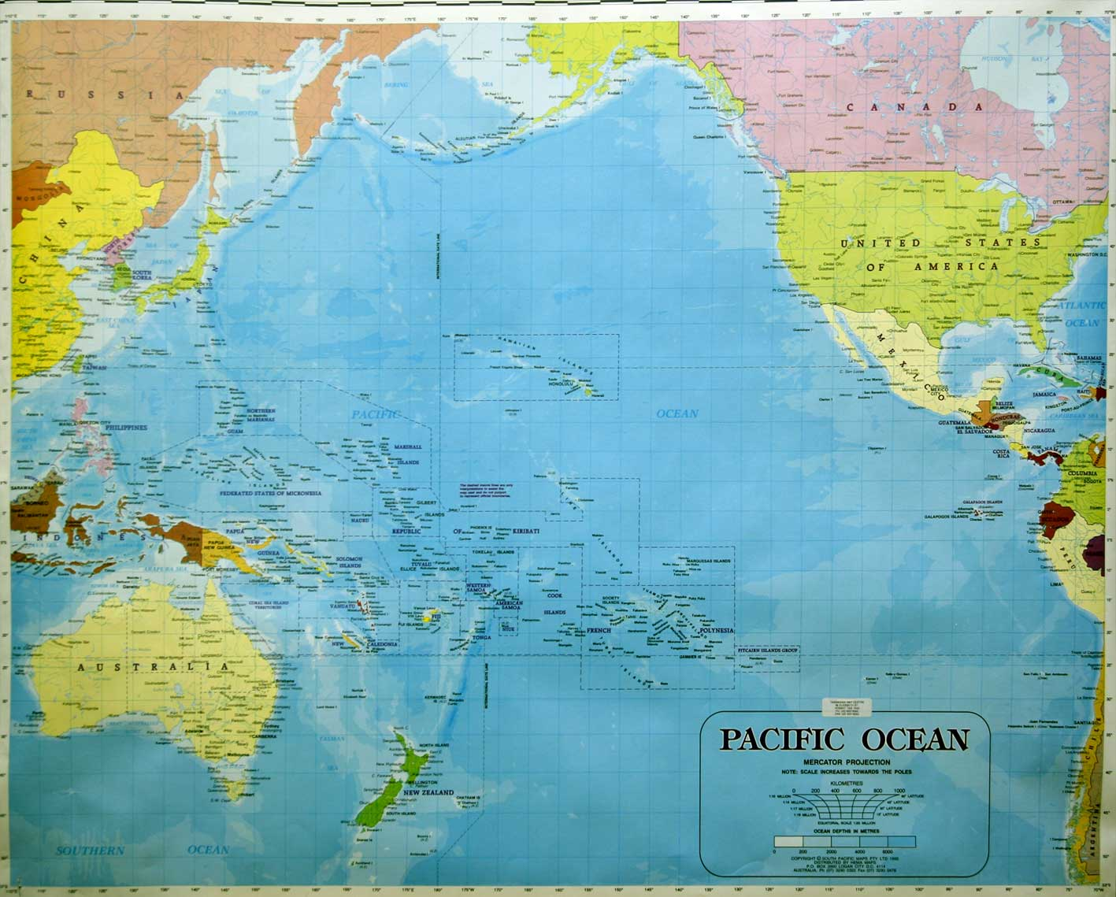
We Are Not Alone!
Notes:
There is a need to develop adaptation planning that would allow us to sail through this impending storm and the aftermath it would bring about as it passes us. With global cooperation and shared resources for the improvement of our environment, we can all succeed in its reversal.
This is why we are here this week, to share our experiences and to learn from the original stewards of America and the Pacific on how we can adapt to the changing environment in a manner that is culturally appropriate and respectful of our traditions. However, we cannot do it alone. Every country must make sound policy, technology, and investment choices that will lead to a reduction in greenhouse gas emissions and potential co-benefits, with a focus on clean and renewable energy sources, energy efficiency and energy conservation.

Slide 9
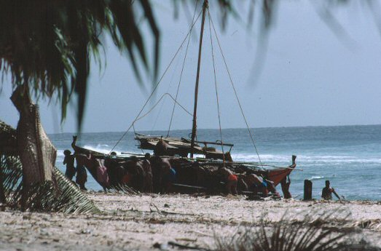
Need to Work Together
CNMI and Federal Gov
Policy Makers
NGOs
Private Sector
Youth
Public
EVERYONE!
Notes:
We need to work as partners, the CNMI and the Federal government, to improve understanding of and promote action on different aspects of climate change, targeting and engaging policy-makers and negotiators, NGOs, the private sector, media, adults, youth and the public at large. As the Refaluwasch have in the past, working together, we can make it happen and with sincere cooperation, and assistance, we can and we will succeed!

Slide 10
MIGRATION!!!
A Solution to Climate Change
Notes:
In closing, I would like to offer one suggestion a solution for climate change when everything else fails-MIGRATION*. I am here before you because my ancestors believed in our navigator who led our people out of typhoon devastated island of Satawal to the island of Saipan. Through cooperation my people had managed to live in peace and in unity with the Chamorro people for over 100 years. Let us hope our brothers and sisters from other tiny islands are able to migrate to other places when that time comes and live with others in unity and in peace.

Slide 11
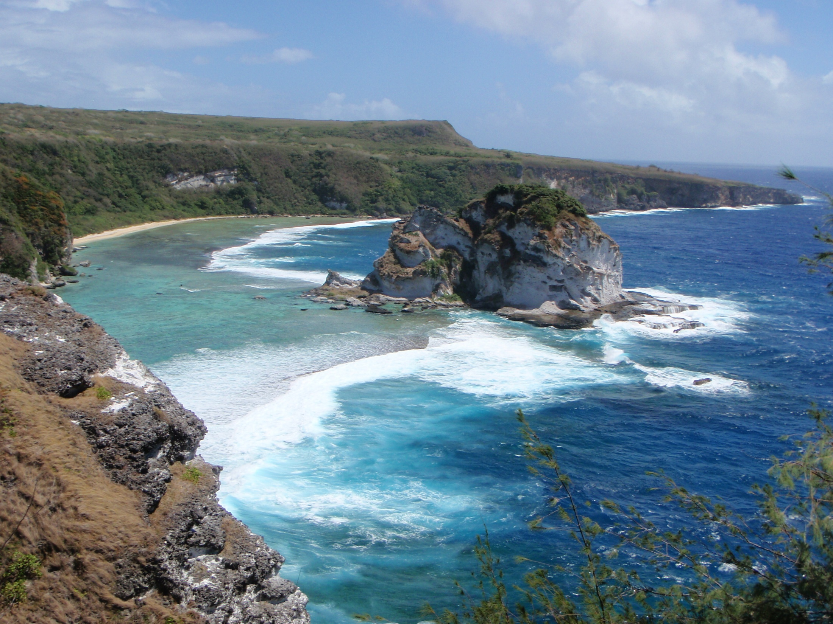
Gilisou
Notes:
Gilisou!

