Slide 1
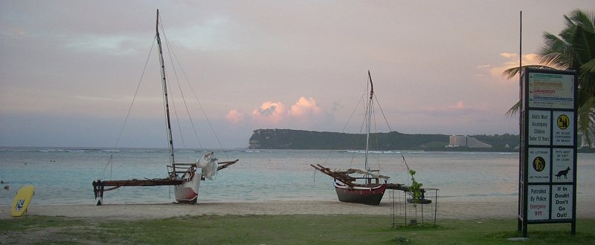
Traditional Sailing Canoes "how we have traveled 8,000 miles and brought one with us"…
Joseph Artero-Cameron, President
Dept of Chamorro Affairs

Slide 2
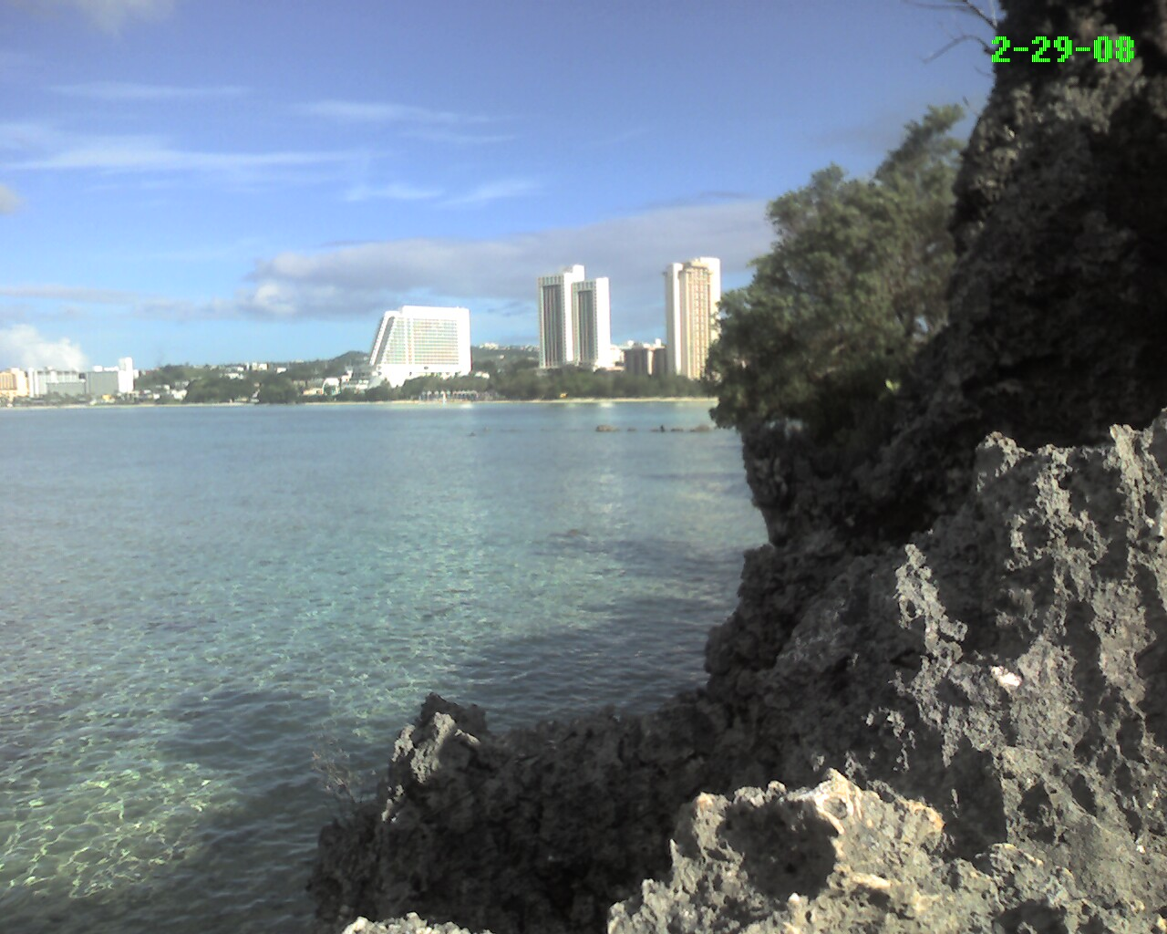
Why Only Climate Change?
Any change that affects the abundance of, or access to, our natural resources matters.

Slide 3
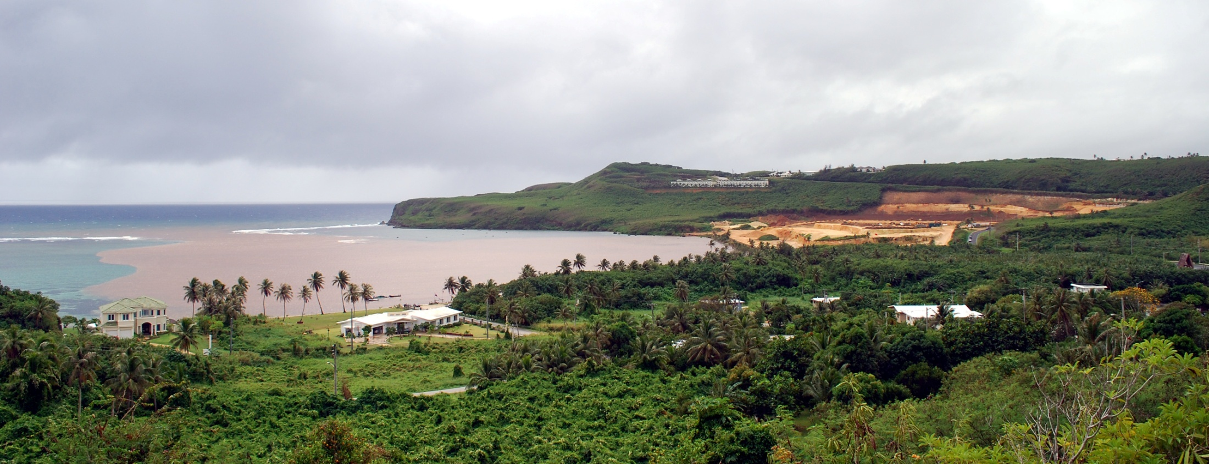
Meteorological Changes
Excessive rainfall causes multiple issues
7in rain, Storm water overwhelms infrastructure
Flooding causes rivers of water on roads are hazards
Loss of land, excessive erosion and red muddy water
Sewers Overflow as storm water goes into the system
Coral reefs get smothered in mud and everything suffers

Slide 4
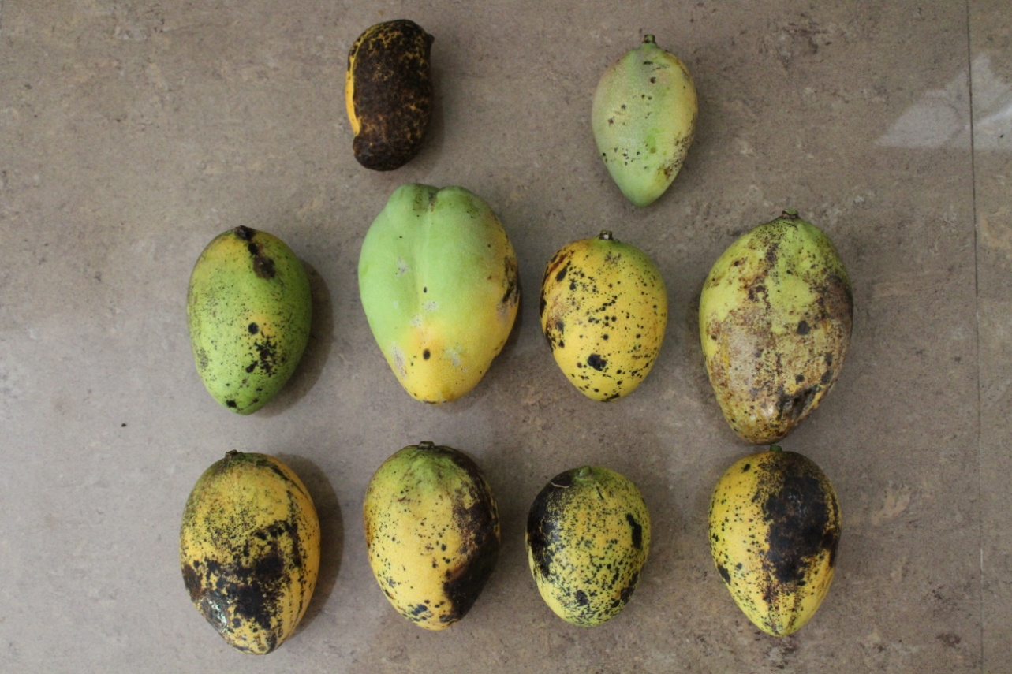
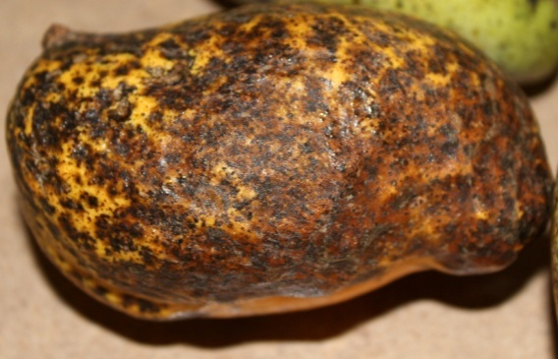
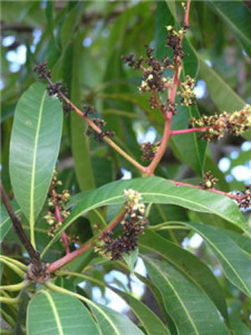
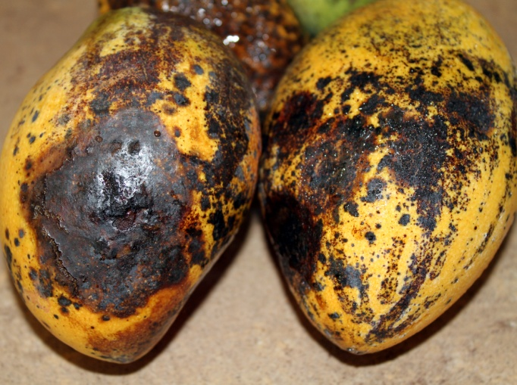
Unpredictable Rainfall
Confuses fruit trees – flower production and new growth, while moisture increases the occurrence of fungal diseases (ex. Anthracnose)

Slide 5
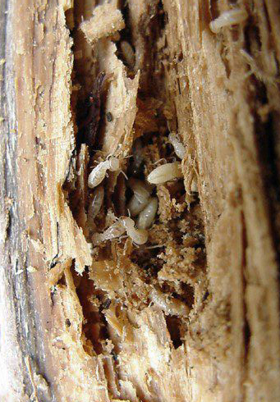
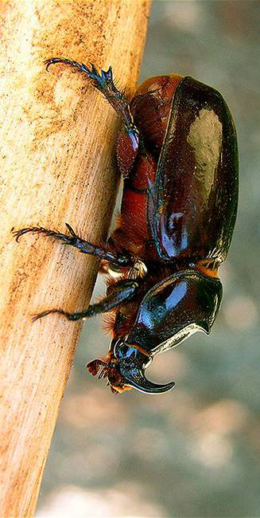
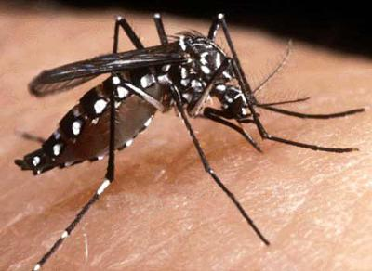
Continuous moisture
Increases insect populations
Termites
Agricultural Pests reduce food production in the islands
Increased moisture provides for easier opportunity to establish Invasive species such as the Rhino Beetle and allow of the expansion of their breeding range
Mosquitoes and other disease vectors

Slide 6
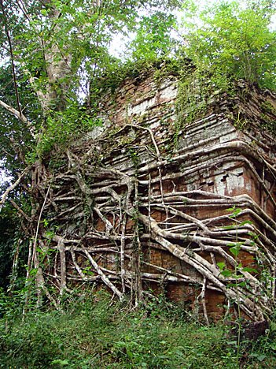
The Vines!
Increased moisture is increasing the growth rates of parasitic and epiphytic vines that kill old trees
Many of these vines are
hitchhikers from our past.

Slide 7
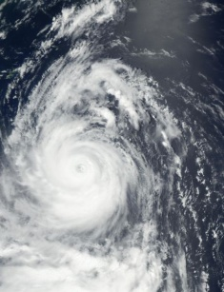
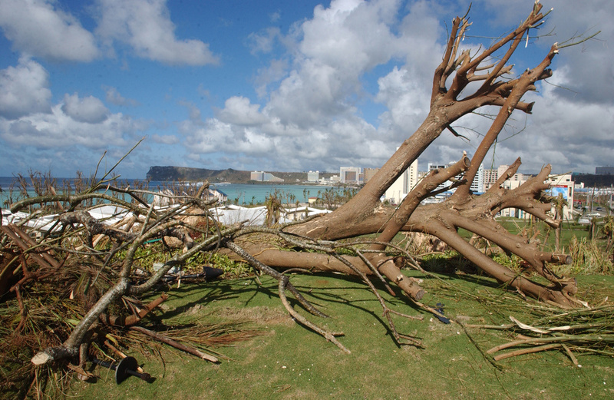
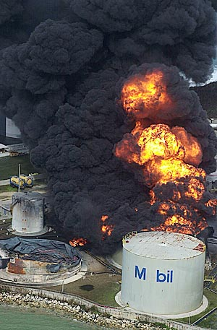
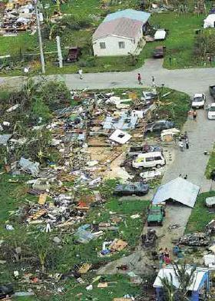
Less, but intense typhoons?
Paka (1997) Guam 236mph declared invalid instrument could not be checked for accuracy.
Eye wall rainfall can be 7in per hour.
Destruction, no power, no water.
Typhoon Pongsona an exemplification of cultural resiliency.

Slide 8
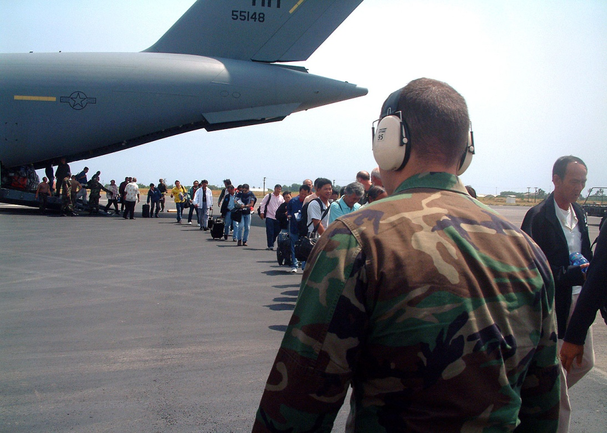
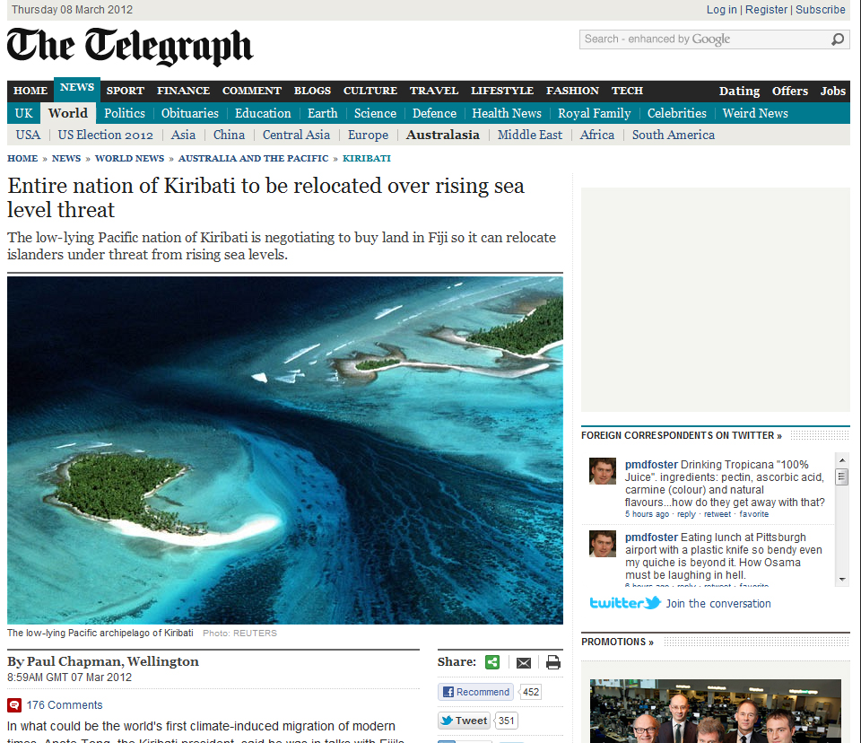
Sea Level Rise?
Regardless of sea level, people are coming to Guam
Increased demand on natural resources from cultural needs and personal desires

Slide 9
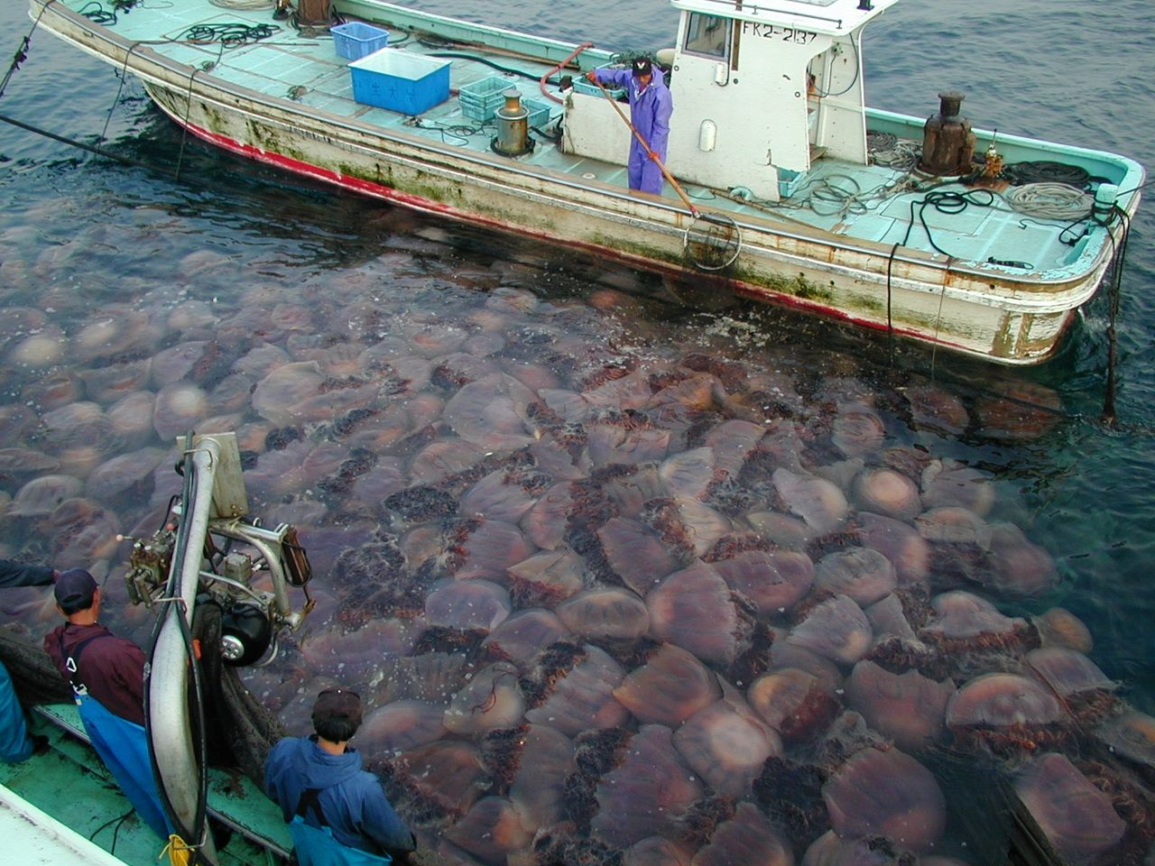
Decline and redistribution of pelagic fish stocks
Increasing dependence on coastal resources

Slide 10
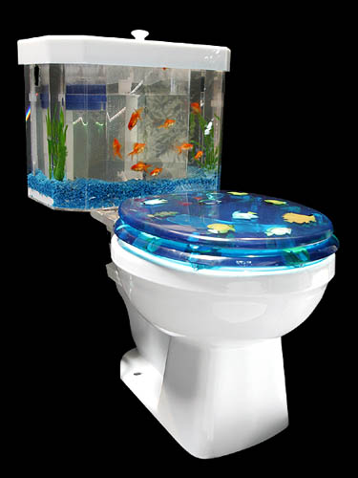
Pollution (Solids, Liquids, Rx drugs)
compromising food safety
decline in availability of natural resources

Slide 11
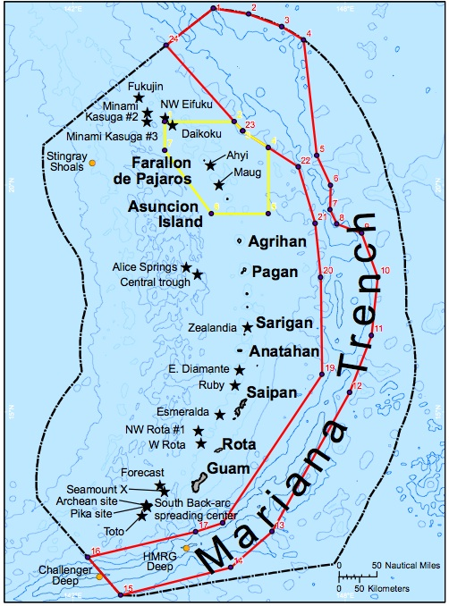
Changes in Political Climate
National and Local Policy are continuing to decrease access to and availability of natural resources
National Monuments and CMSP

Slide 12
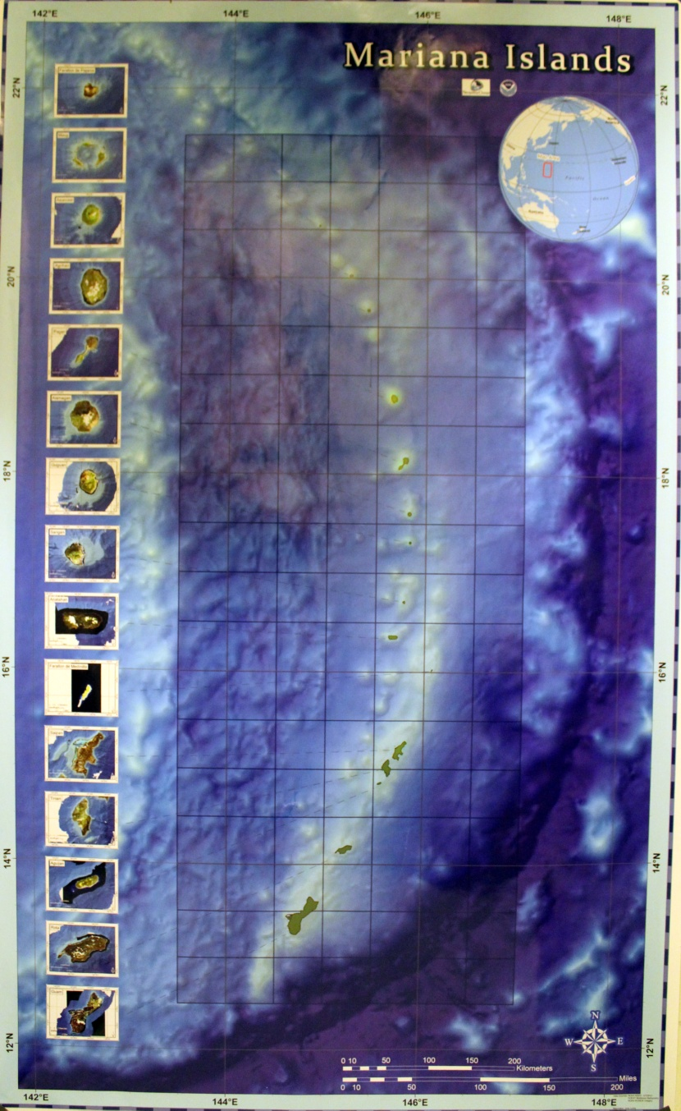
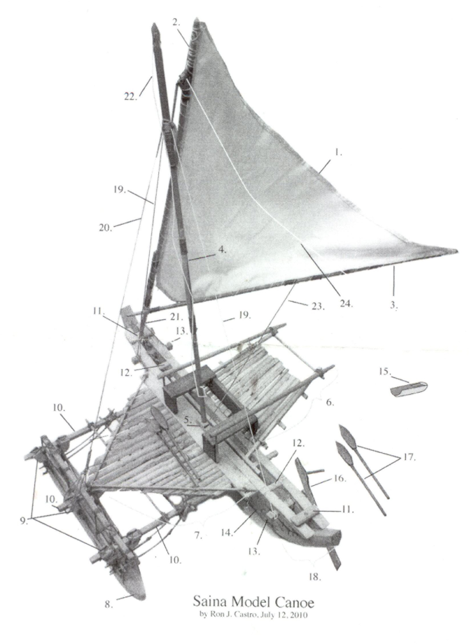
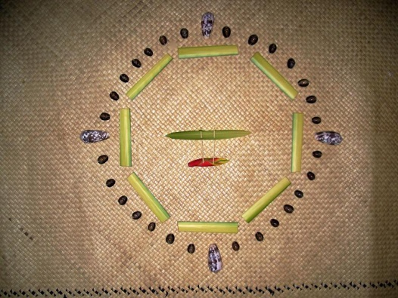
Curriculum adaptations for the Mariana Archipelago based on the canoe concept

Slide 13
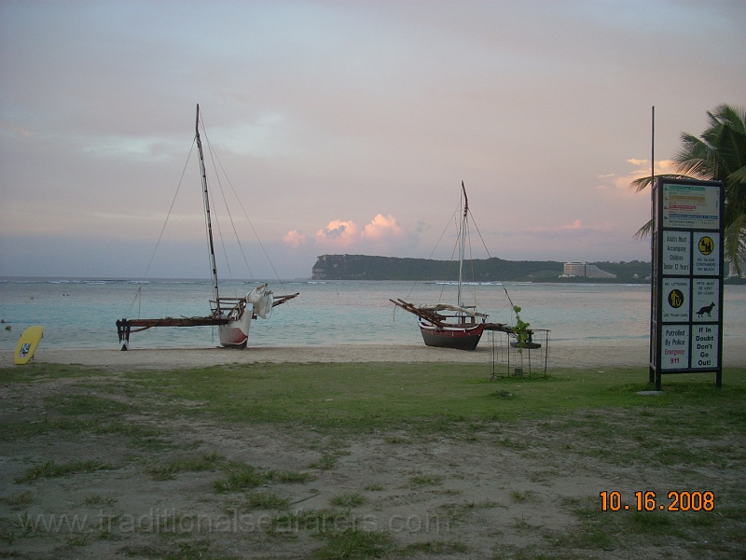
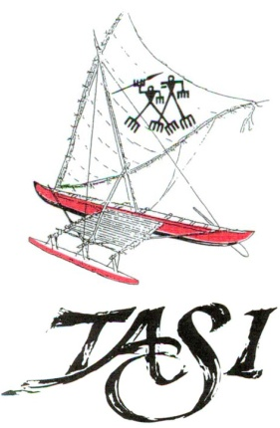
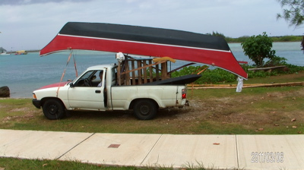
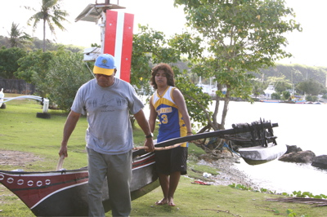
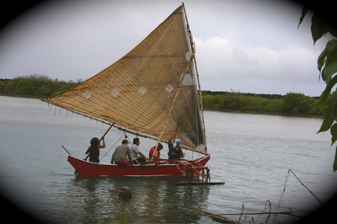
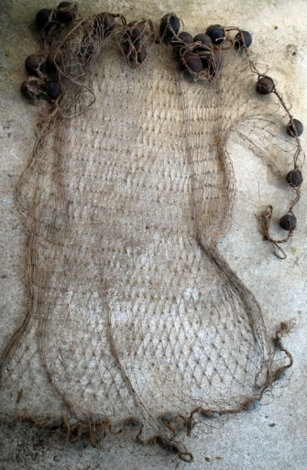
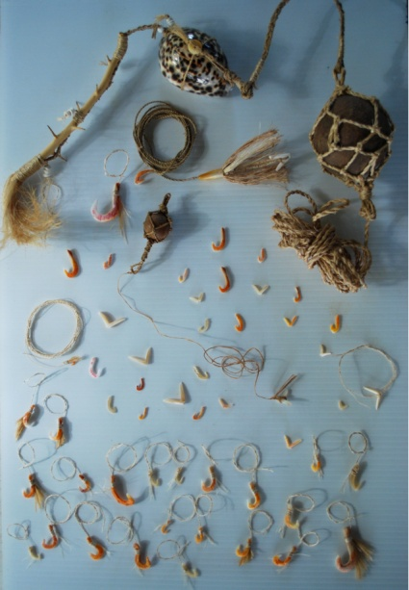
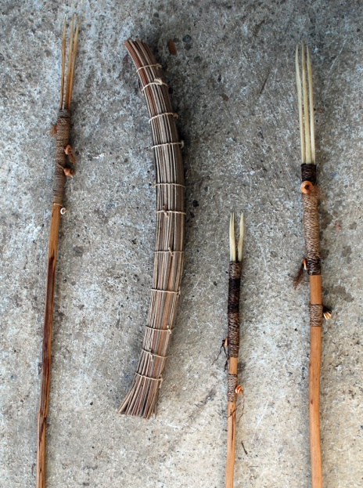
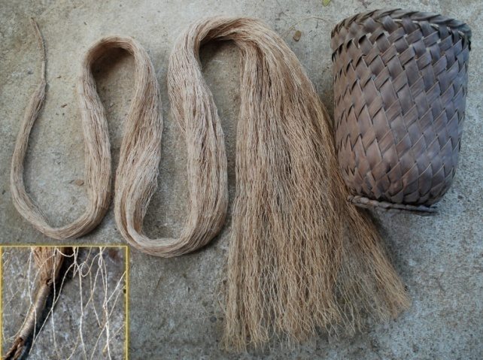
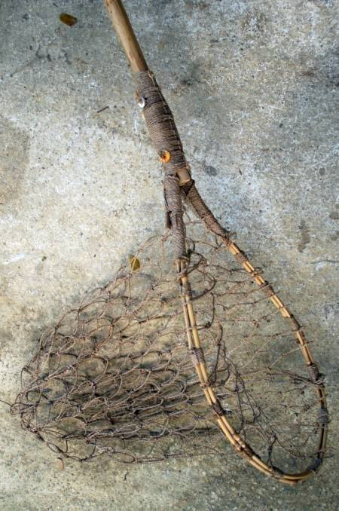
Pre-Contact Fishing Technology

Slide 14
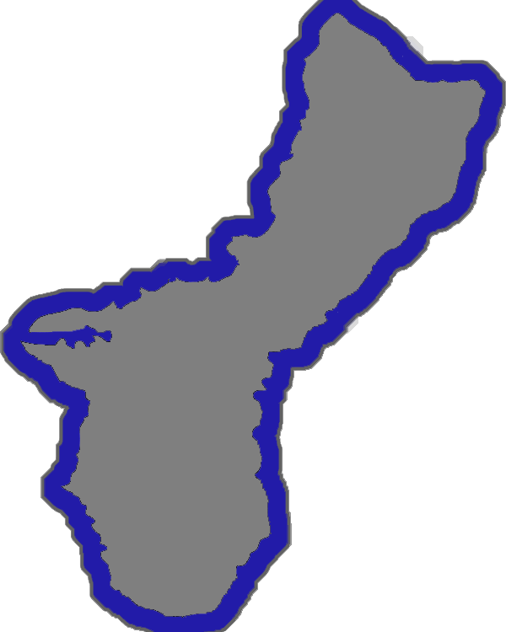
Physical Erosion Model of Guam

Slide 15
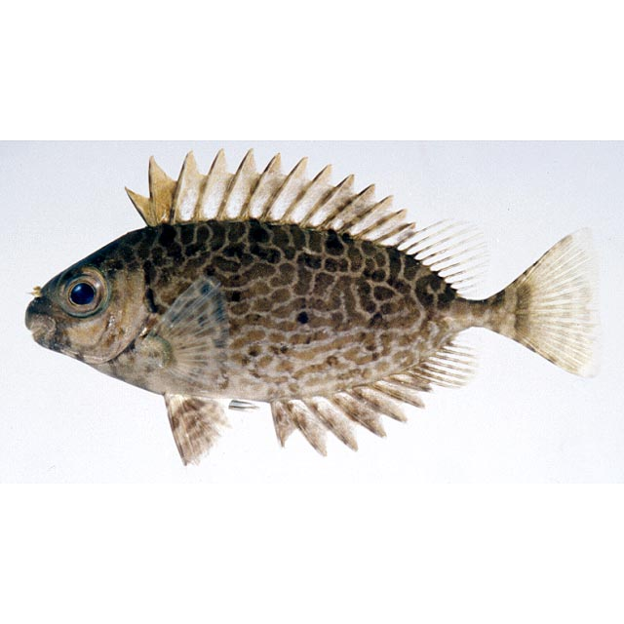
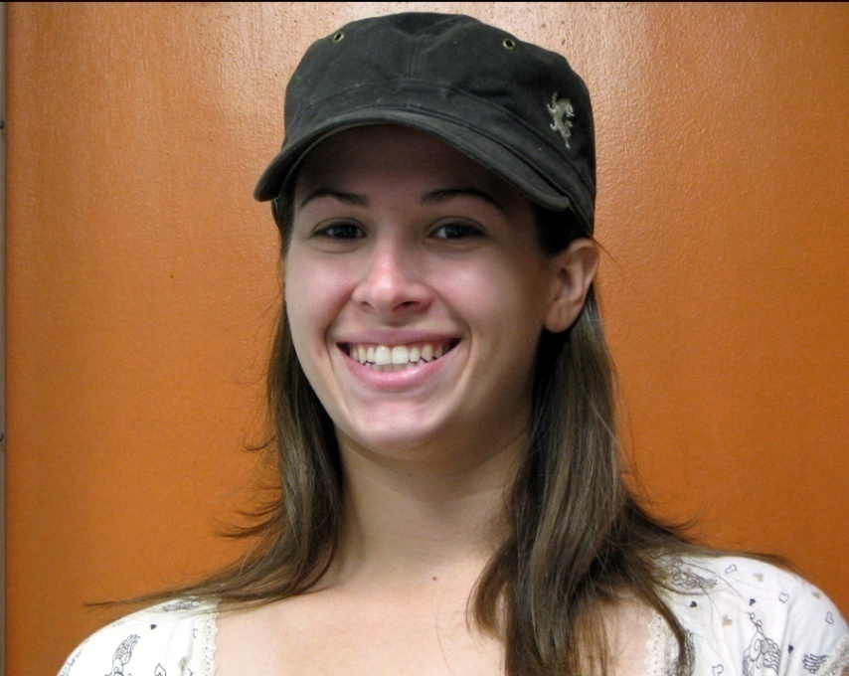
Biological Monitoring of Coastal Pollution
Monitoring the Metabolic Capacity of rabbitfish (Siganus spinus) as a Biomarker of Aquatic Environmental Quality.

Slide 16
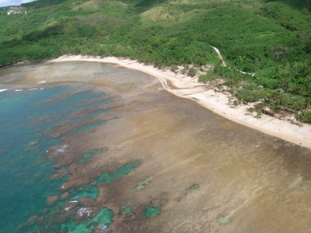
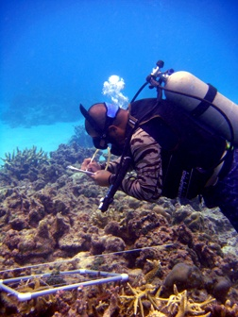
Long-term Monitoring of Coral Reef Disturbance and Recovery

Slide 17
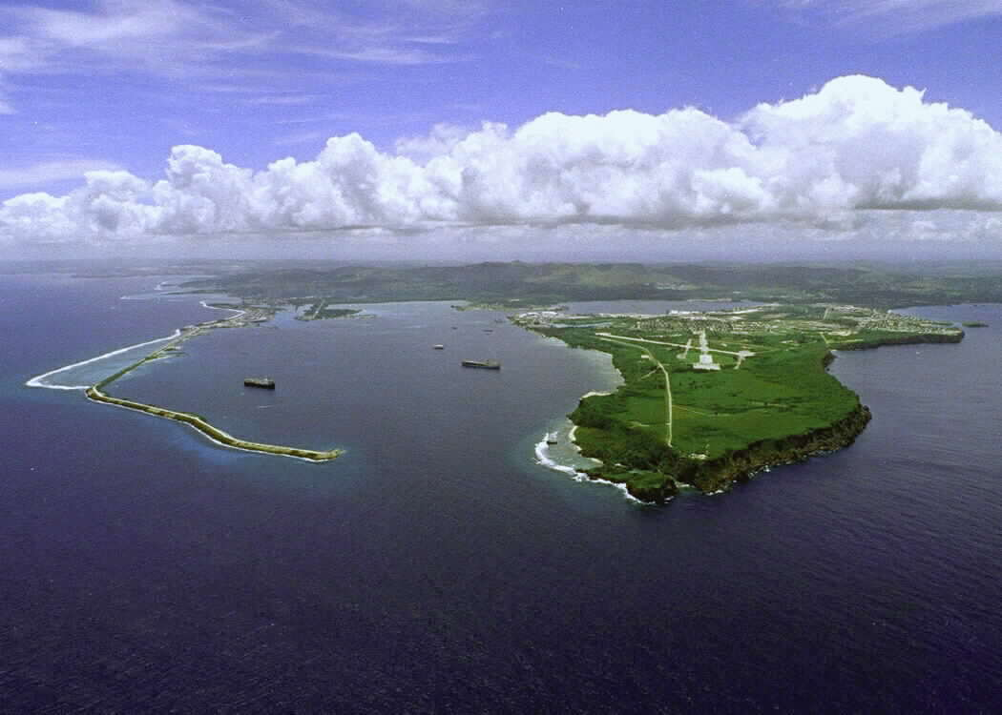
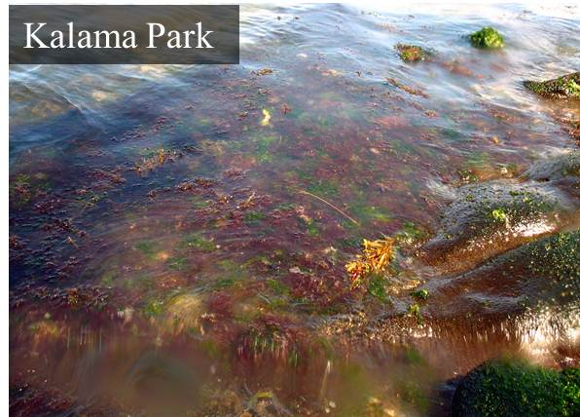
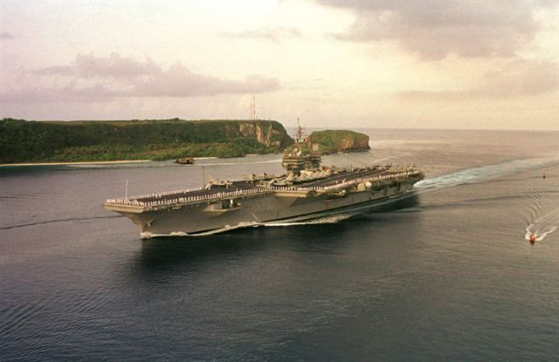
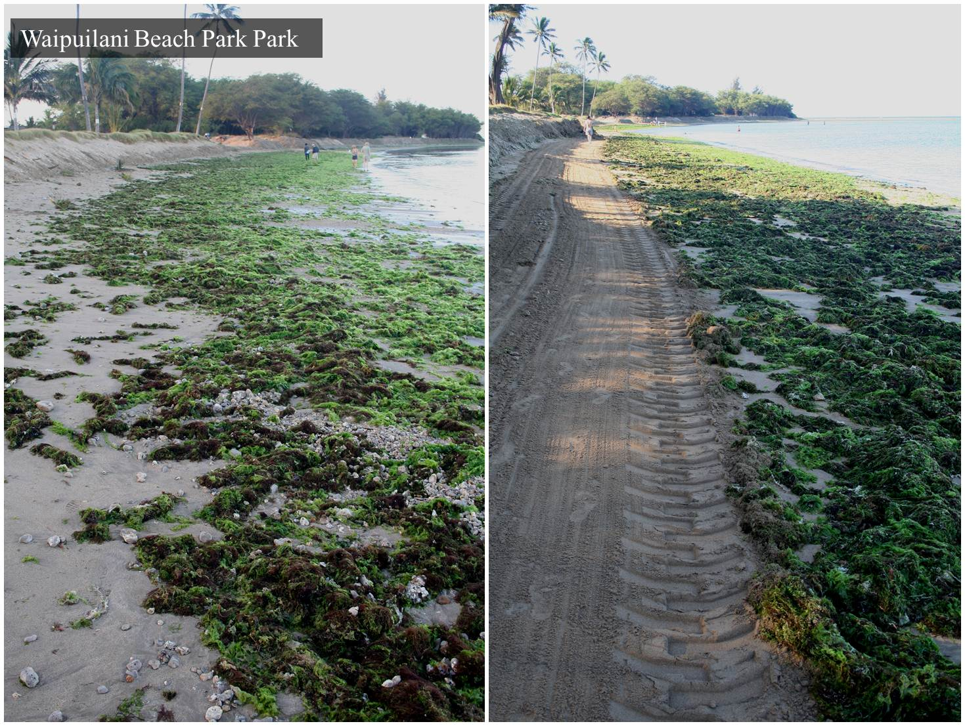
Marine Invasive Species
Reef Chip®

Slide 18
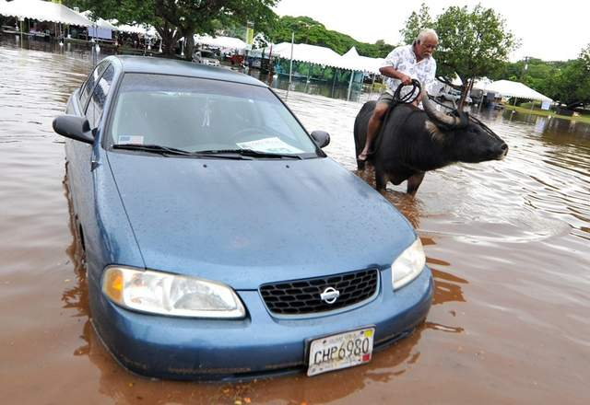
Outside solutions – The adage that one size fits all does not work.
To solve the problem, we must look at the source of the problem and not just the symptom.

Slide 19
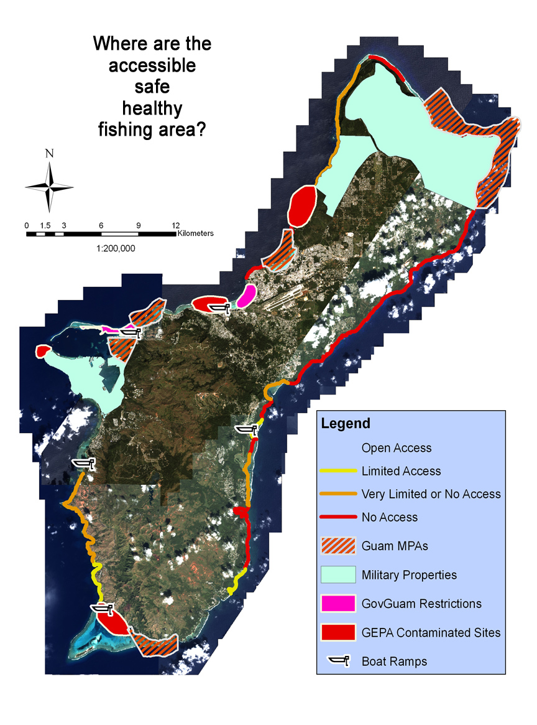

Slide 20
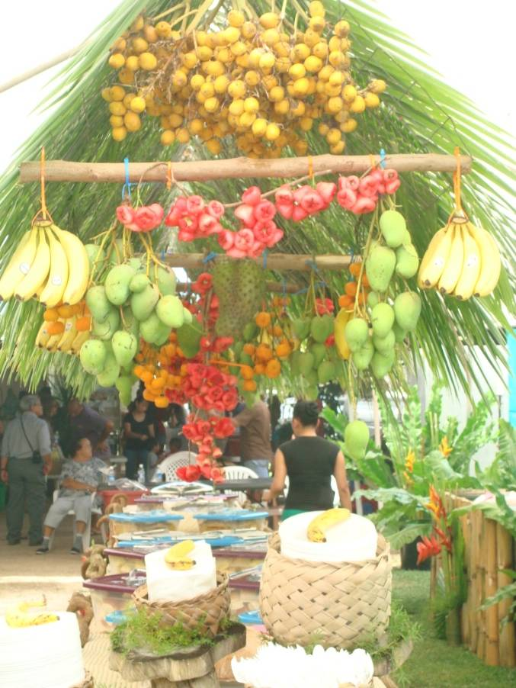
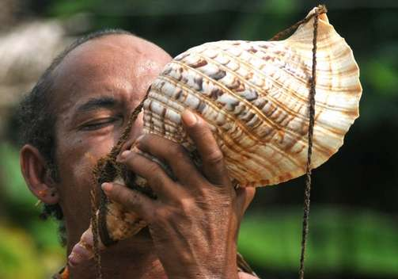
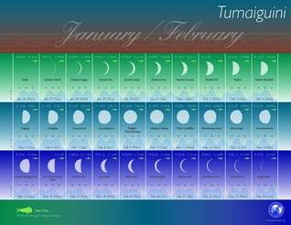
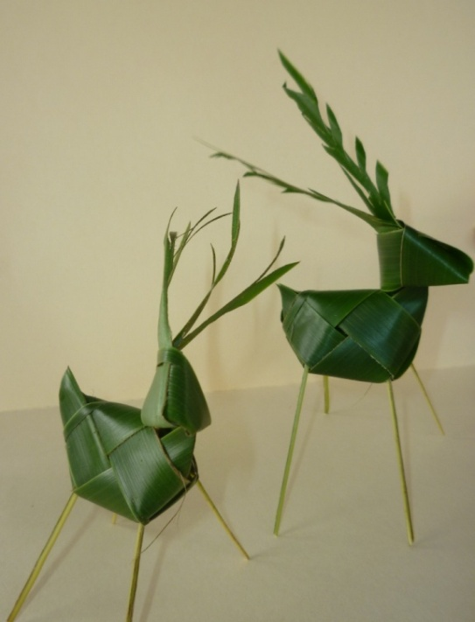
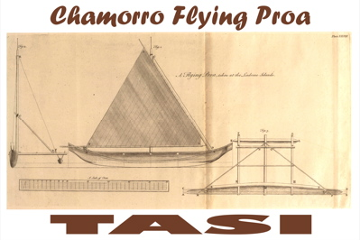
Indigenous Knowledge

Slide 21
Chamorro Value System
Akseptasion – Acceptance: Be willing to understand and appreciate qualities in others
Inafa’målek – Compassion and Caring: Try to understand how others feel and act on those feelings with care and concern
Mana’ayuda - Cooperation: Work willingly with others toward a common goal
Mina’tatñga – Courage: Stand strong for your beliefs and do what’s right even when others disagree
Inagofli’e – Friendship: Accept, share and enjoy the companionship of others
Gineftåo – Generosity: Be willing to share and give what you have to others
Måolek Kotdura – Good Judgment: Make wise choices on what you know is right
Minagåhet – Honesty: Be sincere, truthful, trustworthy and loyal in all that you do and say
Minesñgon – Perseverance: Keep working hard to reach your goals even when it gets difficult
Respetu – Respect: Always remember to show others consideration, admiration and honor
Responsapblidåt – Responsibility: Always be someone others can depend on
Hulat Maisa – Self-Control: Work hard to control your thoughts and behavior

Slide 22
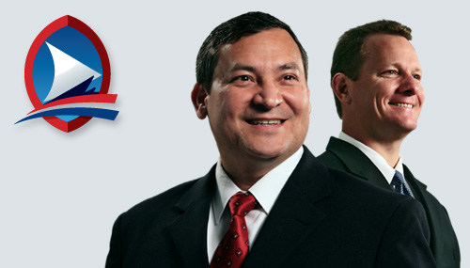
Climate Change Initiatives
“I have called upon my government agencies to ensure that future erosions of our indigenous resources, both cultural and natural, does not happen, and that all of our natural resources are effectively managed to achieve the continuation of our culture and the sustainability of our resources.”
- Eddie Baza Calvo
Governor of Guam
“…To regain our place in history as a hazard resilient island community with plenty of seafood and healthy coral reefs to sustain us, we need to play a more active, rather than adaptive, role in managing our local resources.”

Slide 23
Fishing Forever!!!
“…please keep in mind that we are not just protecting coral, fish, and other animals to make us feel good inside, but we are also protecting the traditions, the cultures, and lives of the native peoples who have coexisted in harmony with the ocean’s incredible resources long before we became a part of America’s family..”
- Eddie Baza Calvo
Governor of Guam
Dangkûlo
na
Si Yu’os Ma’ase!!!

