Slide 1

Communities and Climate Change in Am. Samoa
Ufagafa Ray Tulafono
Am. Samoa Dept. of Marine & Wildlife Resources

Slide 2
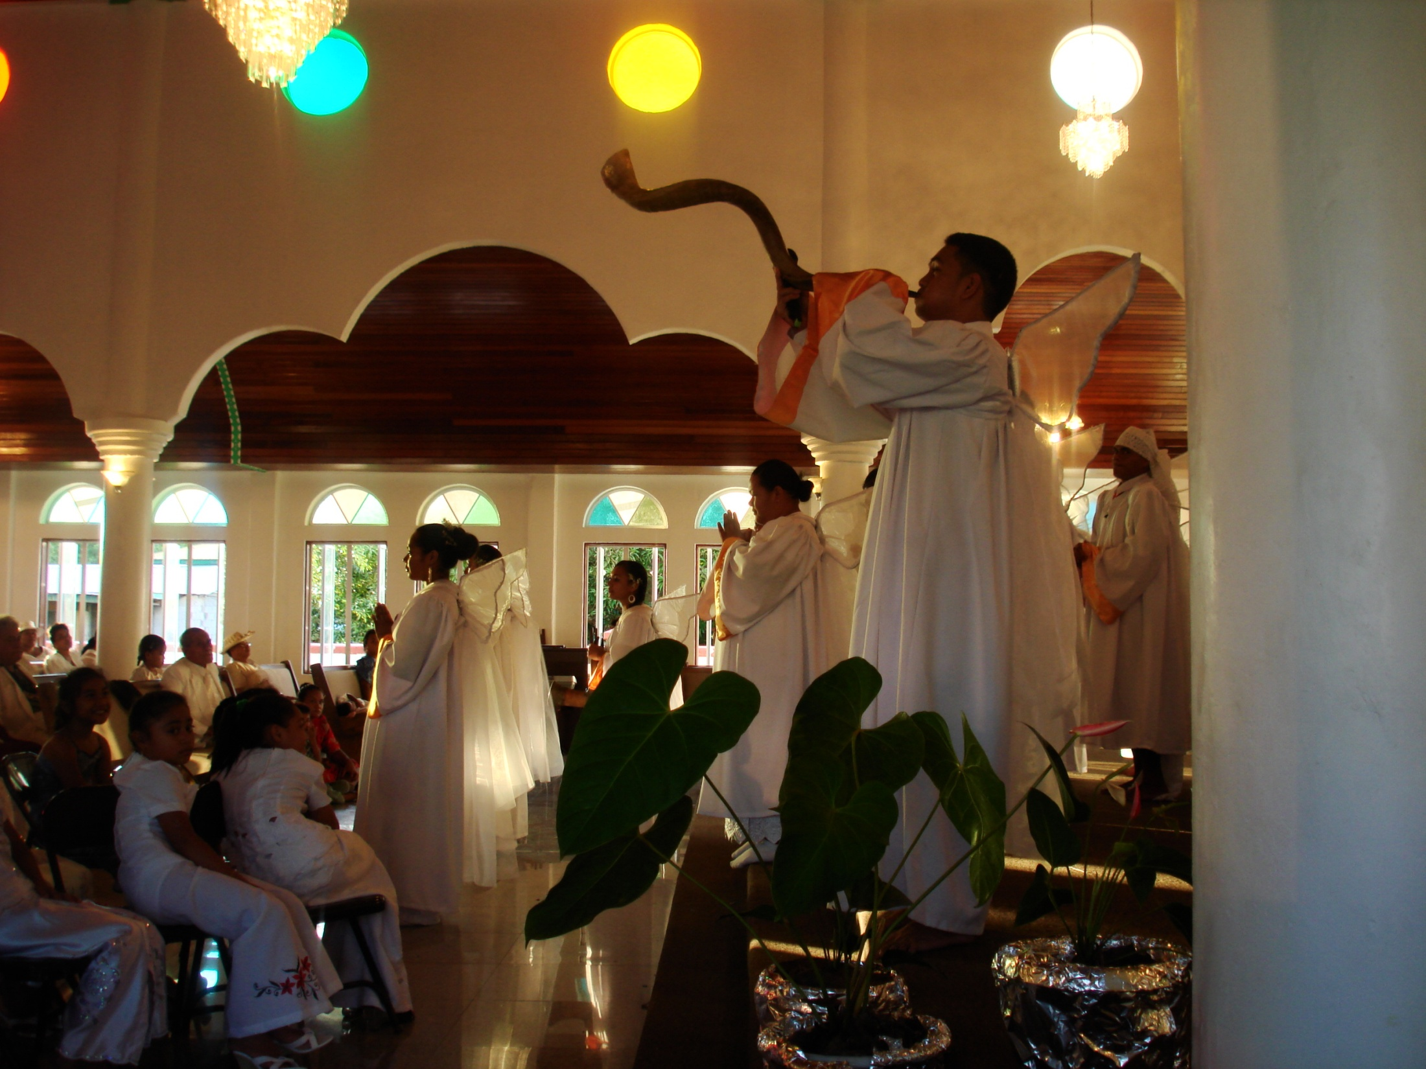
As Samoans, we value
Notes:
As Samoans, we value our God – our faith and belief in him as our sole provider and the protector means our life, our culture – it identifies our values, our traditions and customs that defines who we are as a unique people, our families – and last and probably most importantly our food. Like many cultures around the world, we utlize the resources believed by our people to be given to us by God on land and in our surrounding oceans to be able to sustain daily living and support our livelihood.

Slide 3
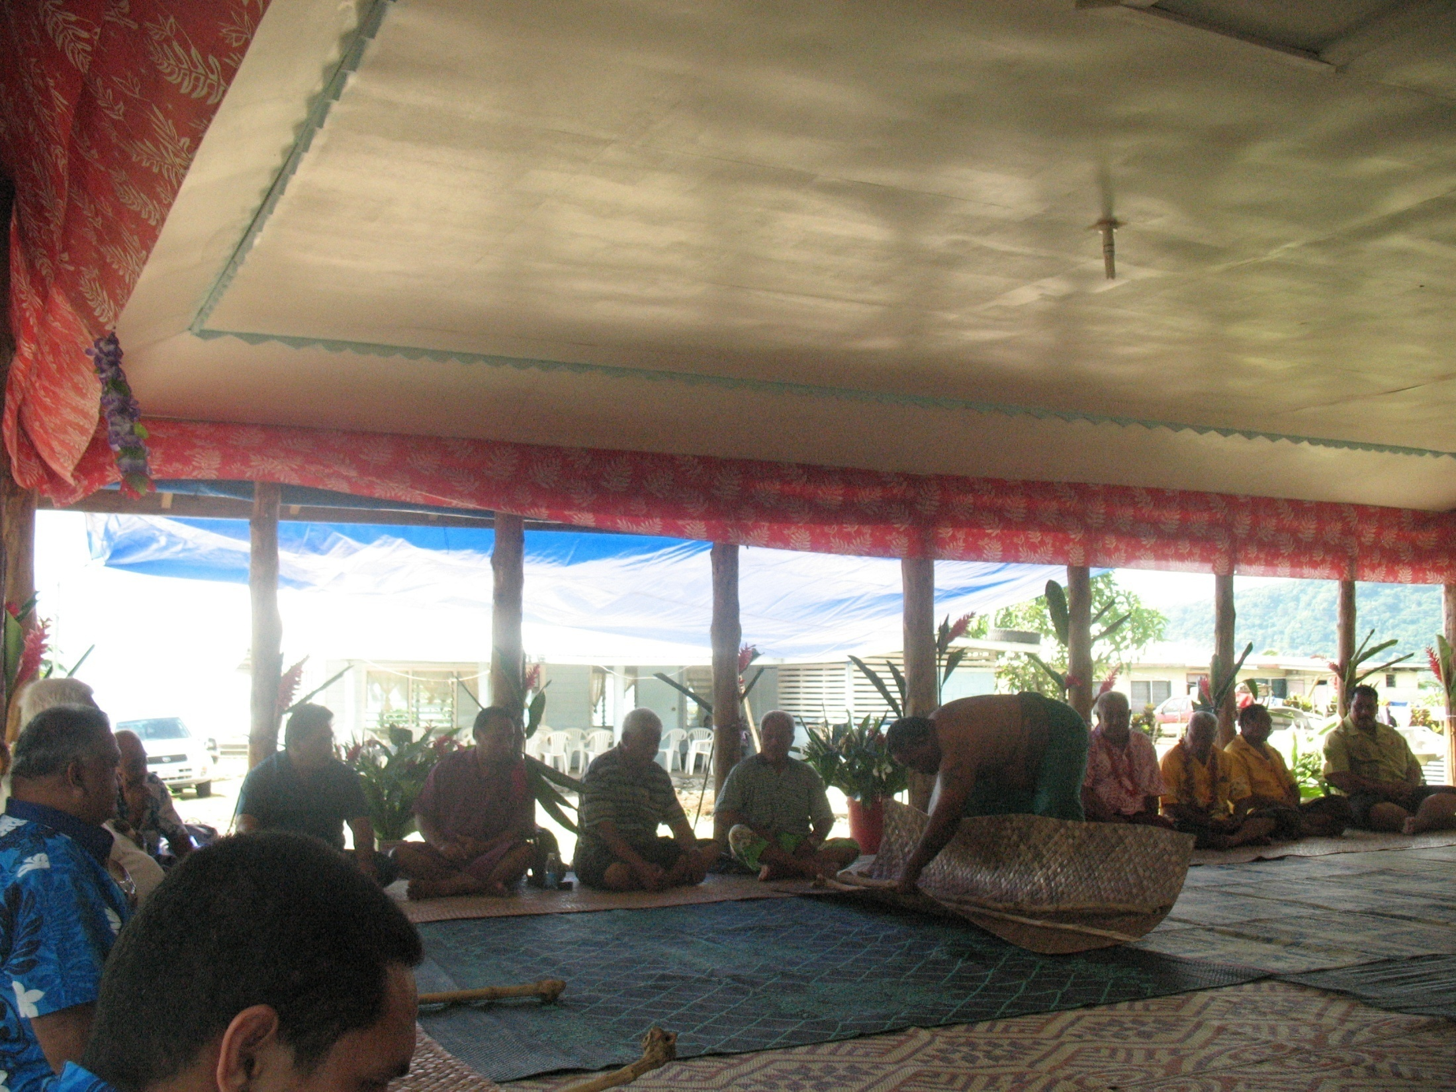
As Samoans, we value
Notes:
As Samoans, we value our God – our faith and belief in him as our sole provider and the protector means our life, our culture – it identifies our values, our traditions and customs that defines who we are as a unique people, our families – and last and probably most importantly our food. Like many cultures around the world, we utlize the resources believed by our people to be given to us by God on land and in our surrounding oceans to be able to sustain daily living and support our livelihood.

Slide 4
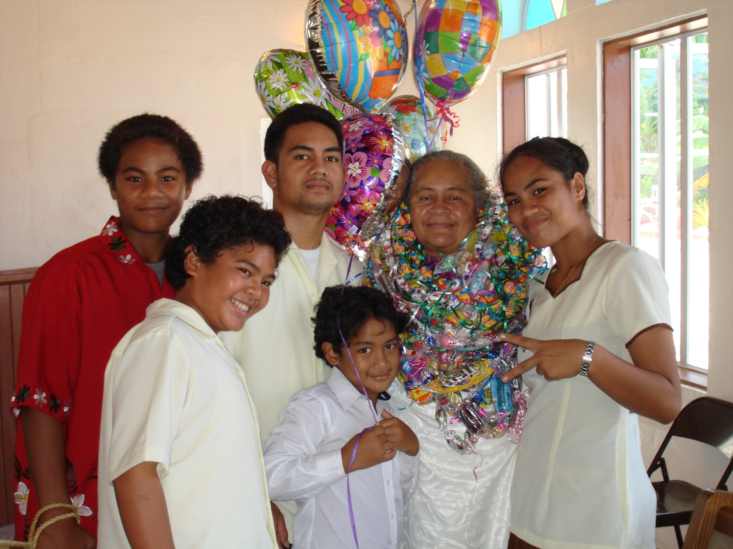
As Samoans, we value
Notes:
As Samoans, we value our God – our faith and belief in him as our sole provider and the protector means our life, our culture – it identifies our values, our traditions and customs that defines who we are as a unique people, our families – and last and probably most importantly our food. Like many cultures around the world, we utlize the resources believed by our people to be given to us by God on land and in our surrounding oceans to be able to sustain daily living and support our livelihood.

Slide 5
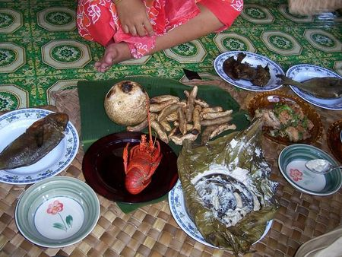
As Samoans, we value
Notes:
As Samoans, we value our God – our faith and belief in him as our sole provider and the protector means our life, our culture – it identifies our values, our traditions and customs that defines who we are as a unique people, our families – and last and probably most importantly our food. Like many cultures around the world, we utlize the resources believed by our people to be given to us by God on land and in our surrounding oceans to be able to sustain daily living and support our livelihood.

Slide 6

What is the problem
Resources are becoming scarce
Resources are disappearing
Ecosystems are being destroyed
Ecosystems are not properly functioning

Slide 7
Why?
Notes:
Traditional knowledge may potentially be lost

Slide 8
Anthropogenic Sources
Pollution
Land Clearing
Overharvesting
Use of illegal harvest methods
Erosion

Slide 9
Natural Sources
Climate Change
  Tsunami
  Droughts
  Hurricanes
  Coral Bleaching

Slide 10
What are we doing about it?

Slide 11
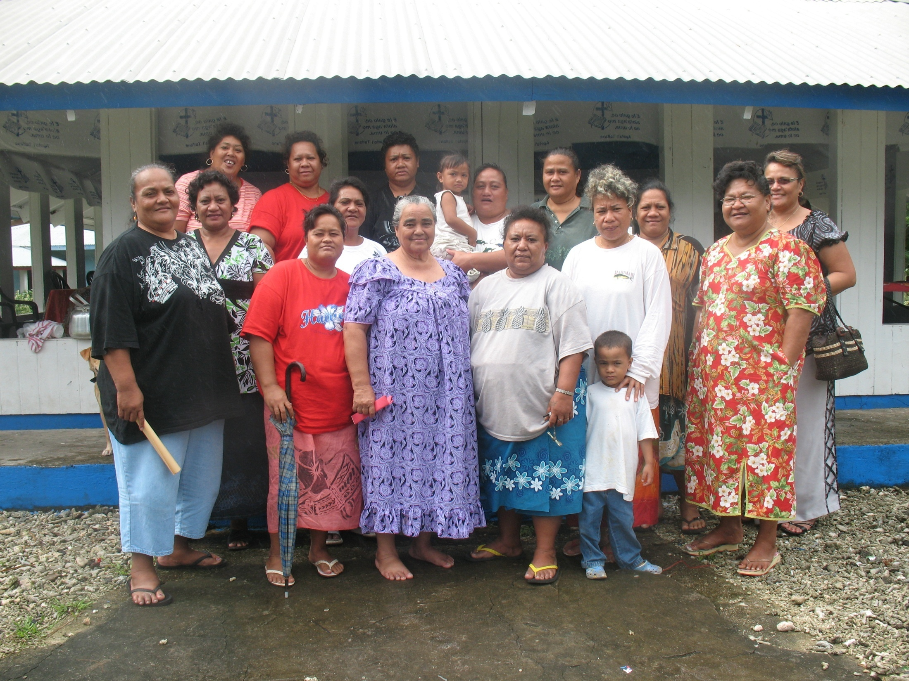
Practicing Conservation

Slide 12
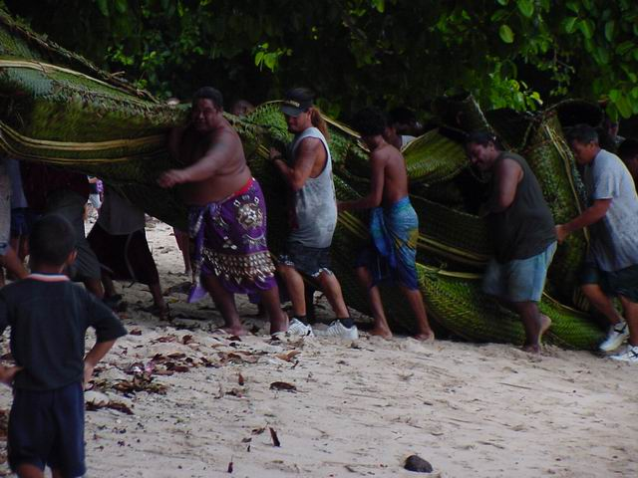
Integrating Traditional Knowledge and Science

Slide 13
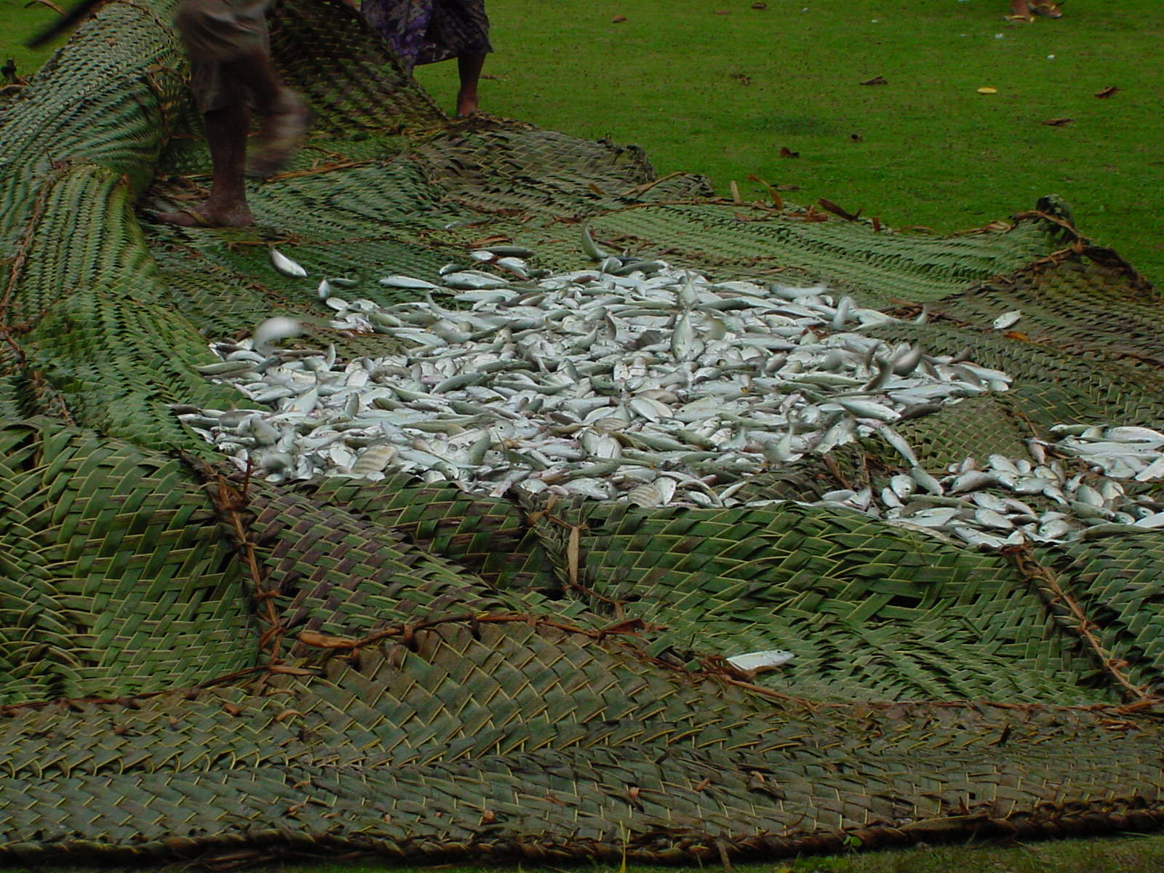

Slide 14
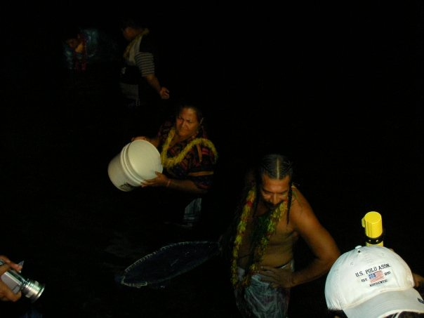
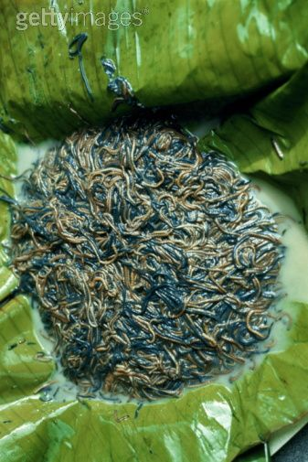

Slide 15
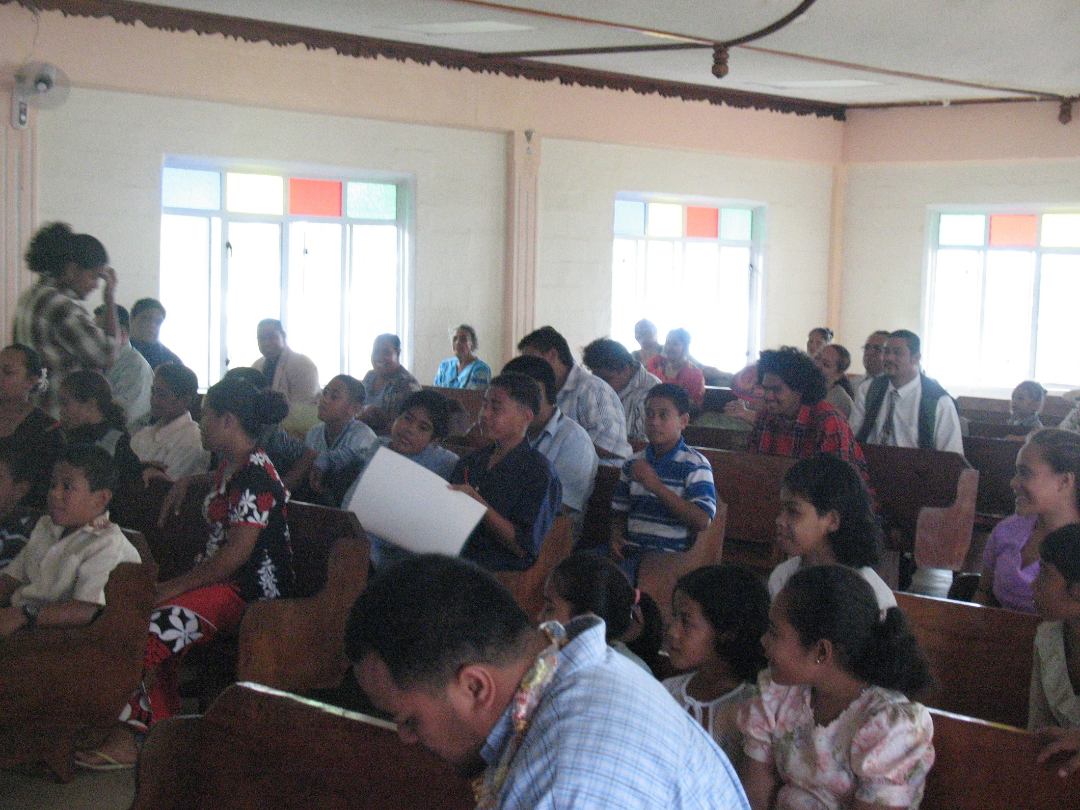
Increasing environmental awareness

Slide 16
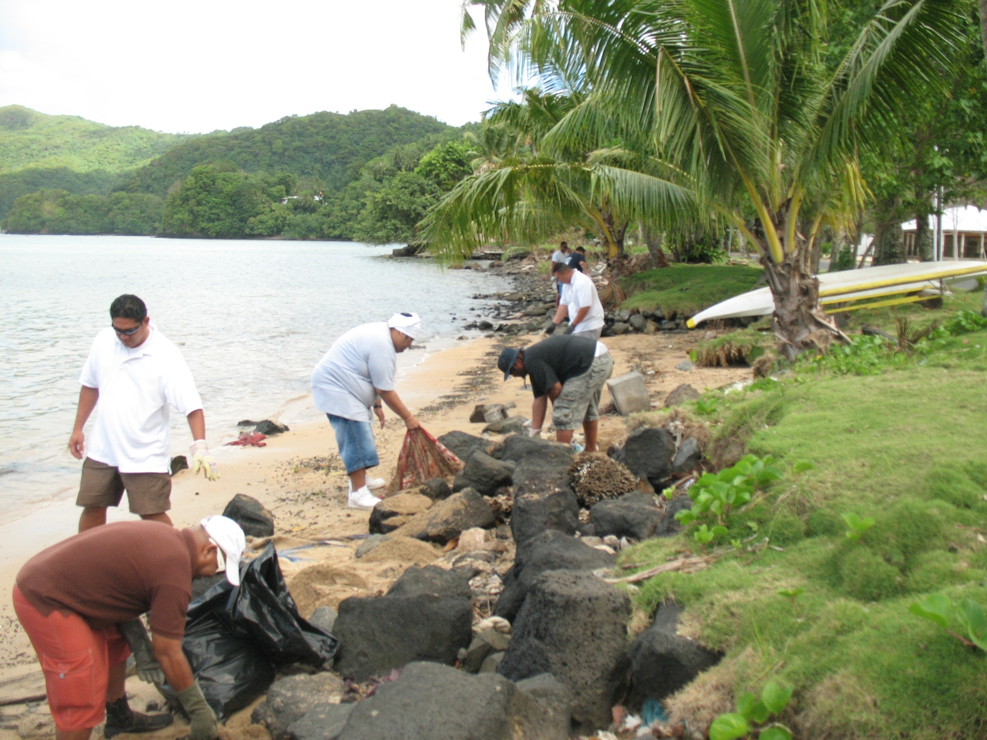
Becoming environmental stewards

Slide 17
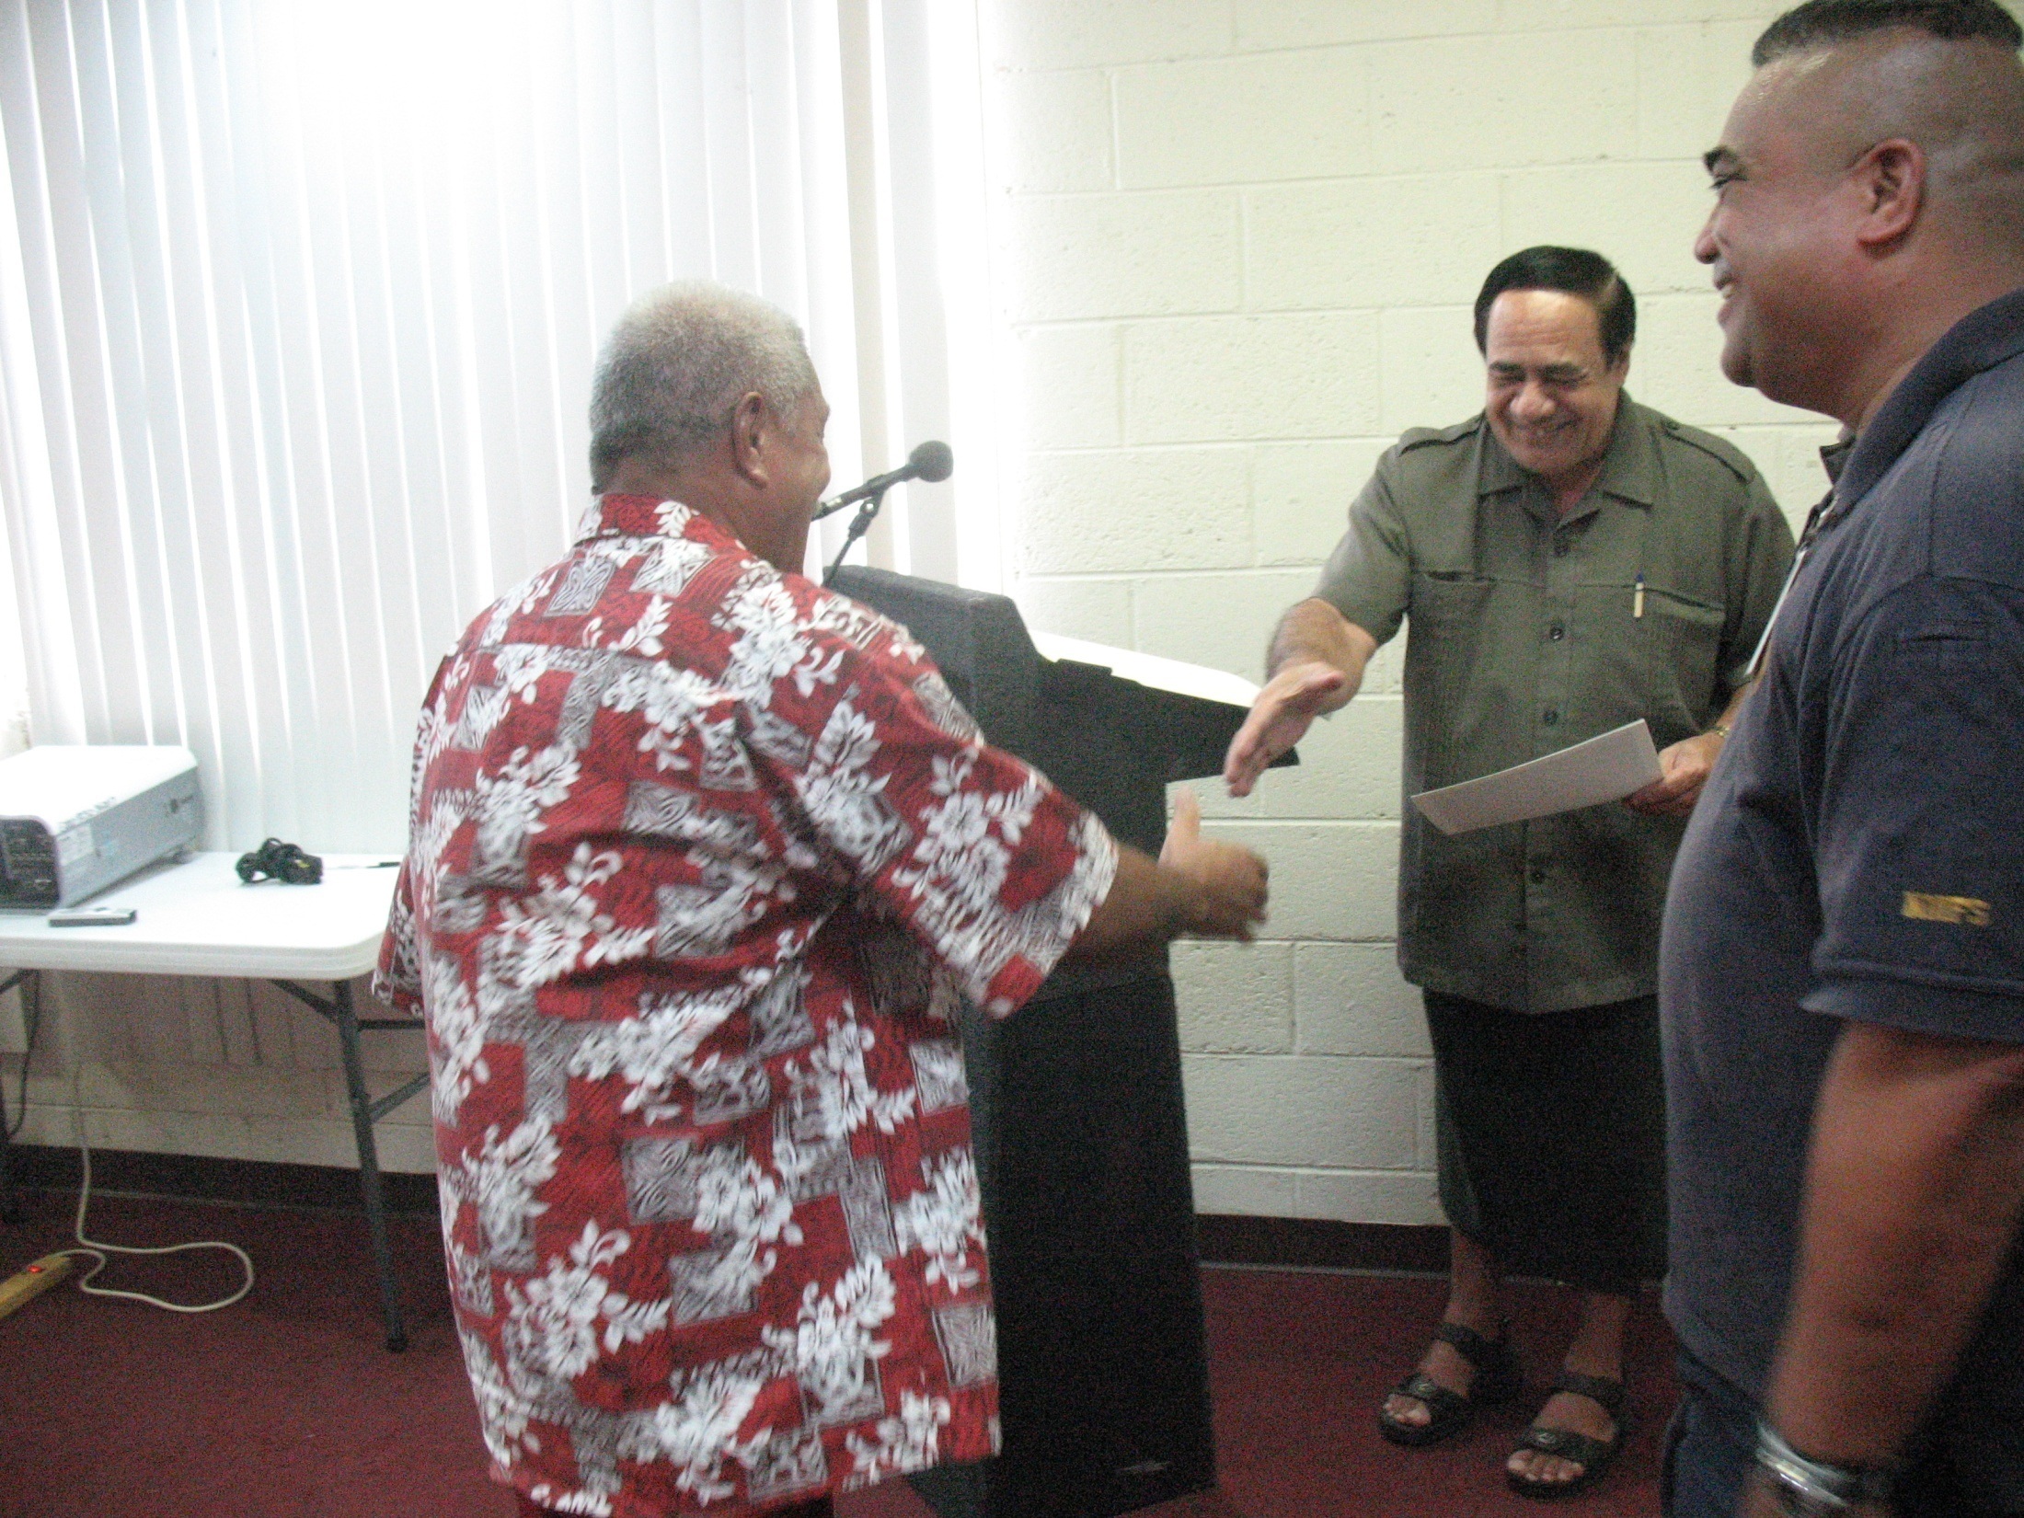
Develop partnership with communities and private sector

Slide 18
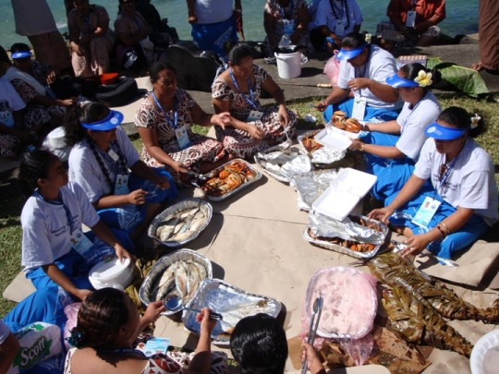
Food security

Slide 19
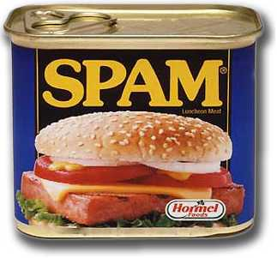
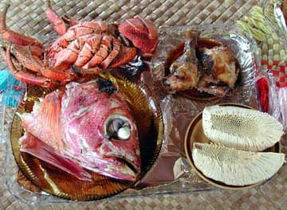
Livelihood becomes expensive and unhealthy

Slide 20
It is our hope that……
We are able to manage and protect our natural resources
Develop environmental friendly behaviors
Encourage food security
Preservation of cultural practices and knowledge
Sustainably utilize our resources
Thinking about tomorrow

Slide 21
Our Island – Our Resources – Our Future

