Slide 1
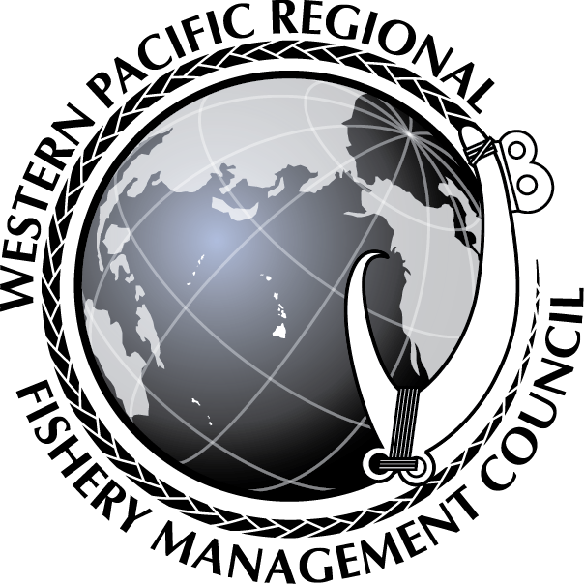
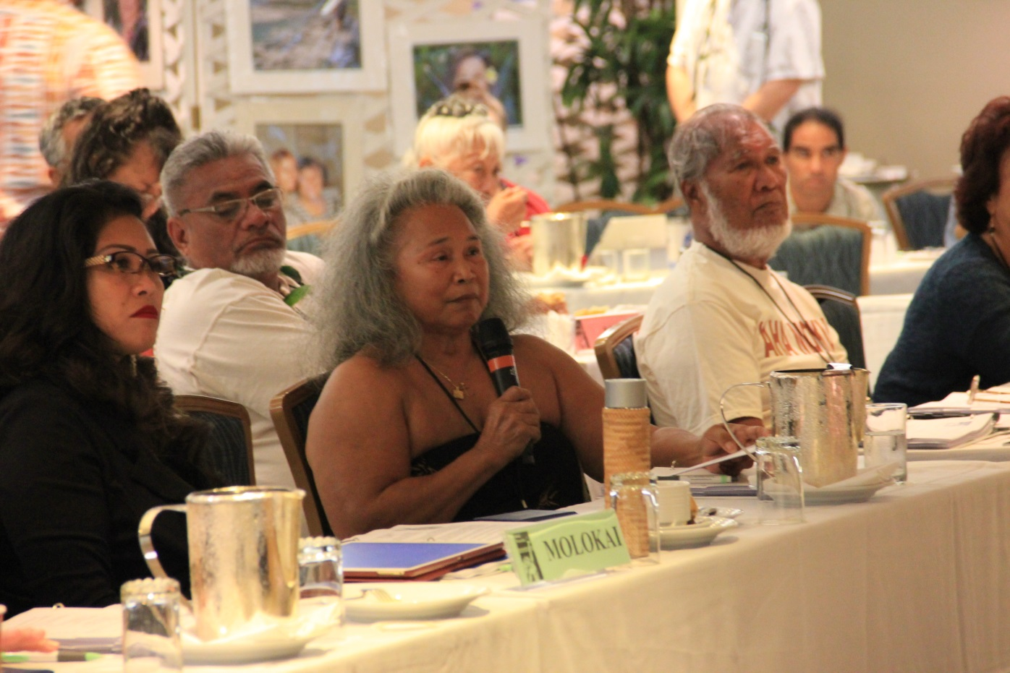
Environmental Justice in Fisheries Management:
The Western Pacific
Kitty M. Simonds
October 21, 2021

Slide 2
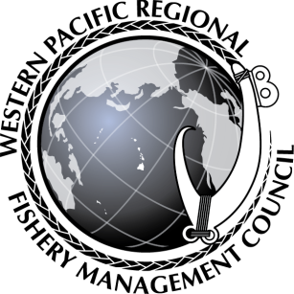
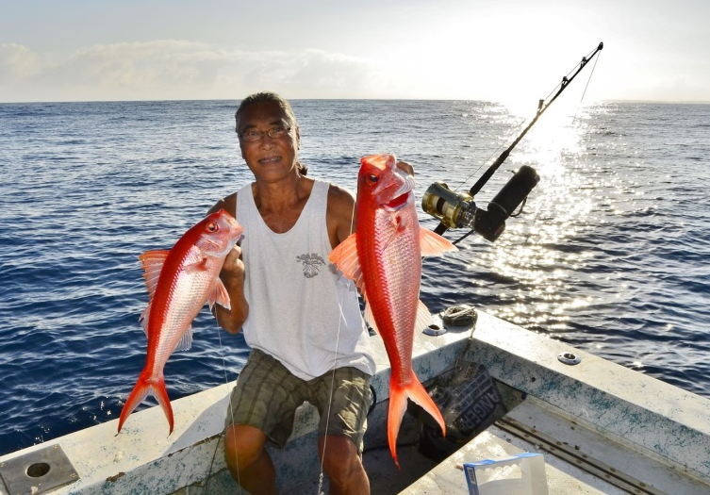
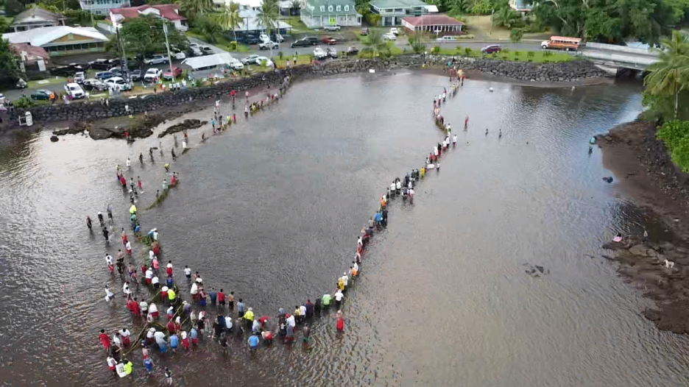
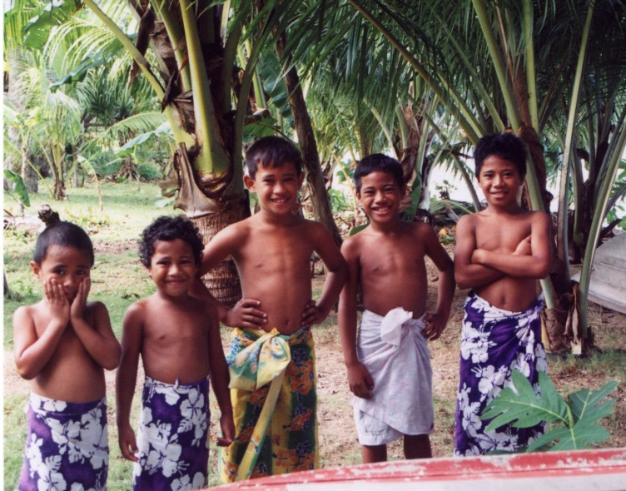
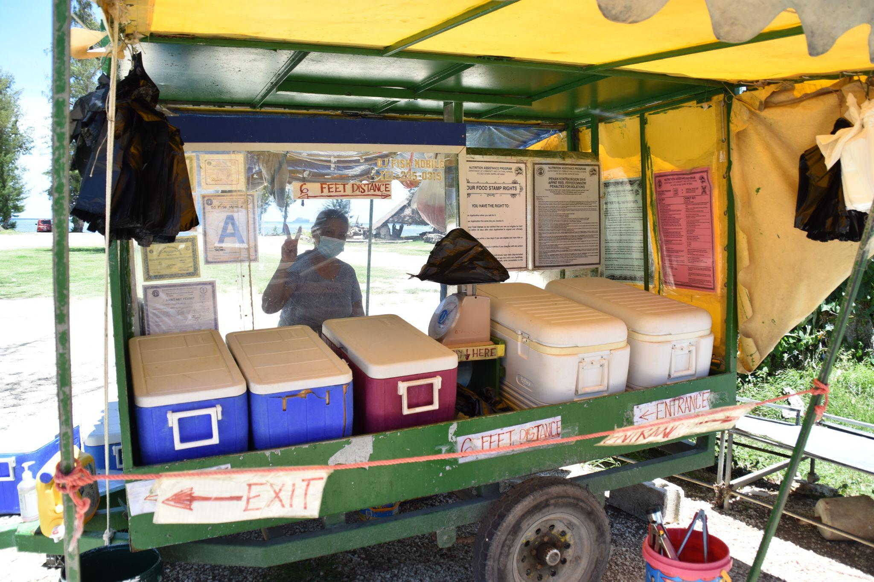
More than 75% of population identifies as Asian American, Native Hawaiian and Pacific Islander (AANHPI)
Samoan, Chamorro, Refaluwasch, Hawaiian
1 State, 2 Territories, 1 Commonwealth
3 Time Zones and the International Dateline
Notes:
The area is vast and the people are diverse. We are surrounded by the Pacific ocean. It connects us as island peoples. We have reciprocal relationships with our marine environment that have shaped our cultures and traditions for over a millennia.
Higher poverty values and lower median income values than National average in Guam, CNMI and American Samoa.
Transportation for goods and services are high and drive up the costs for nearly everything we do.
Top Left: Hook and Line – Ed Ebisui holding Onaga
Top Right: Samoan surround net for Atuli (Akule or Bigeye Scad)
Bottom left: Samoan Keiki
Bottom Right: CNMI Road side fish vendors

Slide 3
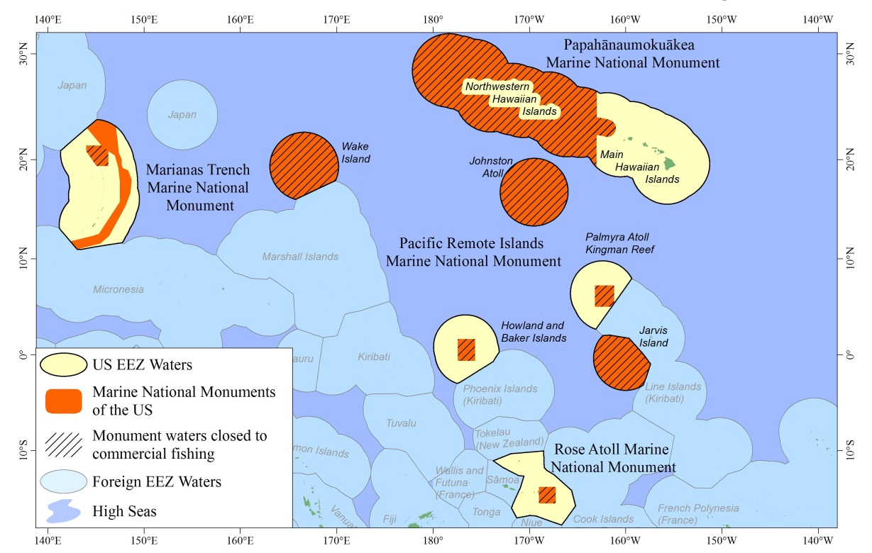
Monuments close off more than areas, they close off access to, and opportunities for – employment/economic opportunities, food security and cultural connections with the ocean and its resources
Antiquities Act bypasses the public process, while MSA includes the public in a bottom-up process to manage fisheries within EEZ
Notes:
Spatial Area Designations: 99.6% of all Marine Monuments exist in the Western Pacific Region of the US EEZ. Antiquities Act : Presidents have the authority to unilaterally designate monuments without community consultation.
The Council has asked President Biden to consider removing fishing prohibitions from 50-200 miles around Johnston Atoll and Wake and Jarvis Islands. Limiting access to our own adjacent US EEZs displaces fishermen to distant water fishing grounds, adding costs, time, logistical burdens. Heavy foreign fishing occurs right up to our 200 mile zone boundaries.
Unfulfilled commitments by previous administrations remain. Promises made, promises not kept. The Territory of American Samoa was promised $10m from the enviros and was also promised a research facility. CNMI was promised a monument visitors’ center. They suggested the Japanese lighthouse on a hill from where visitors could look north and see the monument waters. FWS wanted it placed at the WWII American Memorial Park. A center has not yet been established.
CNMI could benefit economically from foreign fishing for tuna and sharks (china) in their zone. A process in the MSA allows for this to happen. Selling whole sharks, of course.
According to turtle scientists the Hawaiian green sea turtle has recovered. To support traditional fishing practices as authorized in MSA, the Council is working with the NMFS to allow a cultural take. Former Trust Territories of the US do not prohibit the taking of green sea turtles. We have proposed international workshops with countries where the GST traverse such as Philippines, Japan, Malaysia, Taiwan and FSM to discuss management of this shared species.

Slide 4
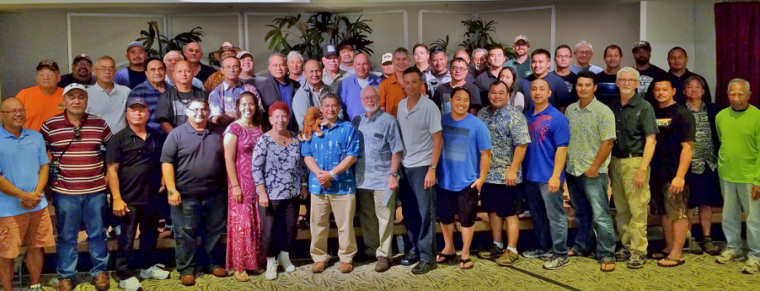
FRAMEWORK AND PROGRAMMATIC SUPPORT
Species-based to Archipelagic-based Fishery Ecosystem Plan
Restructured Council family AP, PT, REAC, SC
Council 5-Year Program
Support community engagement - Guam and CNMI village mayors, Hawaii Aha Moku System, American Samoa Matai System
Indigenous Island Coordinators
Develop Community-Based Fishery Management Plans – Village of Malesso (Guam); Northern Islands (CNMI); AS Enforcement
Assist governments in developing fishery projects, disaster relief assessments (AS/Guam), facilitating user conflict issues between Guam and Federated States of Micronesian fishers
Work with communities on amendments to their FEPs
Notes:
Final Rule and implementation in Jan/Feb 2010 (Final Action 2005). This paradigm shift allowed the Council to integrate new institutional structures resulting in activities and programs allowing communities to share, understand and document traditional resource management practices.
Regional Ecosystem Advisory Committees were established for each archipelago bringing in local and federal agencies, ENGOs, etc. Together they support ecosystem based fishery management of Pacific Island fishery and coastal resources.
Hawaii - Aha Moku – support a formal structure where indigenous communities can participate and provide input into local, state and federal resource management.
Guam and CNMI - Village Mayors –Assisted in developing community-based natural resource management plans for local and federal agencies to consider and address when working with communities
American Samoa –Matai System include village chiefs– supports ecosystem monitoring training for climate change. Provided inflatable zodiacs to support community monitoring
Held and supported a regional CMSP workshop in Honolulu in 2011 with 125 fishing and indigenous leaders attending from AS, CNMI, Guam and HI. The Coastal and Marine Spatial Planning training workshop was held with NOS to learn the concepts and methods of CMSP. 33 teachers from the CNMI and Guam attended the PIFSC’ Ocean Watch Program workshops on monitoring watersheds organized and hosted by the Council. Topics included geology, data collection and water quality monitoring.

Slide 5
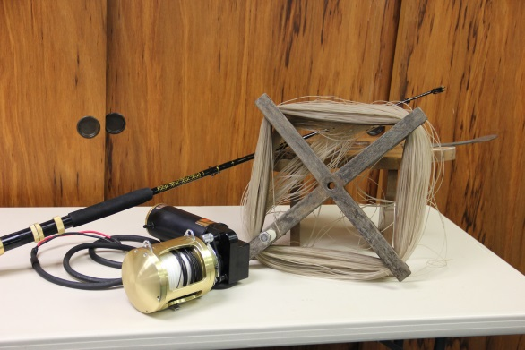
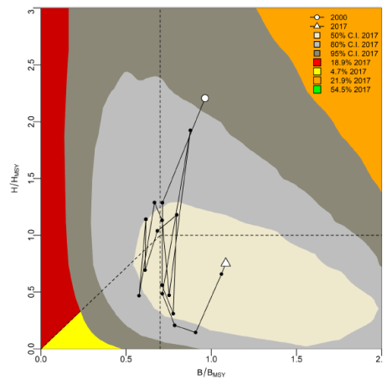
DATA-POOR FISHERIES
NS1 guidance for data-limited stocks doesn’t work!
WP data collection programs need to change to improve the current system to meet MSA requirements
MSA should be tailored for regional flexibility to avoid unrealistic burdens on island communities.
A. Samoa Bottomfish ACL - 106,000 lbs → 5,000 lbs
Guam Bottomfish ACL - 66,000 lbs → 31,000 lbs
CNMI Bottomfish stock status high uncertainty (Kobe plot)
Reduces communities’ economic stability in the absence of clear data-driven management
* 2019 NMFS PIFSC Territorial BF stock assessments
Notes:
(Manny’s suggestion: find a way to record all the fish information)
The idea of a “one size fits all” approach to management is not appropriate.
The level of investment into the building blocks and drivers of policy decision-making -- data collection, plays a large role in implementation success. The region is often faced with a mismatch in policy directives as opposed to regional management needs, with exemption requests as the only viable option.
Unfortunately, this is the case with the application of MSA’ s National Standard 1, which determines stock status. When applied to our data-poor fisheries, it unrealistically burdens these underserved communities by dramatically reducing the catch limit. Proof of the data poor status is the Kobe Plot (as displayed) for the CNMI BF stock assessment that shows large uncertainties covering most of the area of the plot reducing their economic stability in the absence of any clear data-driven management.
WHAT ARE WE DOING? 30 years of recording important data through workshops, contractors, training, Catch-It Log-It, etc. Created fishery data collection and research committee (FDCRC) to coordinate the data collection improvement in the region. We are not a member of a Commission so we do not have that expertise.
NMFS supports bio-sampling in CNMI and Guam, and working to establish sampling in Am. Sam. Council supports bio-sampling in Hawaii through its Coral Reef Funding. These programs need to be reviewed in coordination with other data collection programs (CPUE) to produce better stock assessments. CNMI bio-sampling program is being underutilized.
FDCRC finalized the 2022-2026 strategic plan with a focus on data collection improvement. The goal is to improve the data collection as the building block for SA and fisheries decision making.

Slide 6
COMMUNITY INVESTMENTS & REPRESENTATION
Technical and Administrative Capacity
WP communities lack technical/administrative capacity & resources to compete in national funding competitions - Saltonstall-Kennedy / Bycatch Reduction Engineering Program
Regional solicitation, review and distribution of funds - Cooperative Research Program
Representation and Meaningful Engagement
Memberships on federal/national advisory bodies ensure Pacific Island perspectives are considered - MAFAC
Integration of Traditional Ecological Knowledge into management – Document Fishermen Observations
Work with traditional governance systems and communicate in indigenous/local language
Matai system in American Samoa
Village Mayor structure in Mariana Islands
Aha Moku system in Hawaii
Notes:
Economic opportunities for the insular areas of the Western Pacific are limited due to its geography and available resources. The people need to have the technical and administrative capacity to competitive proposals to better compete in national federal grant competitions, such as:
Saltonstall-Kennedy
22% of $11.1M to the Pacific Island Region, 17% of $11.1M to the US Pacific States/Territories
Bycatch Reduction Engineering Program
10% of $2.2M, 75%: ISSF (Canners) FAD Project $168K; 487 Pacific Purse Seine; 15 US Purse Seine
HLA SSLL Turtle Project went unfunded in 2021 ($50K) – Real time cooperative bycatch mitigation through a shallow-set longline fishermen network
(Largest management issue in our LL fisheries)
Is there really a choice?
Those with the capacity, such as large universities, receive funding.
Providing regional solicitations for these programs, paired with technical training workshops, would afford Pacific island communities an opportunity to receive much needed funding to improve their fisheries.
Western Pacific community representation on federal advisory groups and participation at national workshops continue to be a challenge. Representation is also a key solution. Members of the WP Community know the issues and solutions best so serving on mechanisms closest to the decisions is ideal.
*Note: Past MAFAC membership included diverse representatives – Samoan, Japanese, Haole
These decision making bodies that have the ability to disproportionately affect the region. For example, the Marine Fisheries Advisory Committee deals with national fisheries and policy issues and has not appointed persons from this region for years, despite qualified applicants applying annually.
Community engagement must consider language, traditional governance structures for effectiveness.
WHAT ARE WE DOING: Meet w/advisors and fishing community to document annual ecological trends, changes and events into the Annual SAFE reports. Understand and record the annual cyclical fishing trends.
Continue advocating for regional empowerment for decision making, especially grants and promoting community members for national committees.
NOTE: Administration for Native Americans, Dept of Health and Human Services, used to provide grant training in the territories.

Slide 7
MSA SUPPORTS AANHPI
Marine Education and Training
US Pacific Territories Fishery Capacity-Building Scholarship
Marine Science Course on Fishery and Resource Management
Pacific Insular Area Fishing Agreements
US Participating Territory Specified Fishing Agreements - Hawaii Longline Limited-Access Permit and US Pacific Territories
Projects funded - Guam Fishing Platform, American Samoa Longline Gear Diversification, CNMI Bottomfish Development and Training
Community Development Program
Provides access to traditional fishing practices through regulatory relief - exemption of basket-style gear in longline closures
Community Demonstration Project Program
Provides direct grants of $500K annually (unfunded since 2011) for up to 5 community infrastructure and fishery development projects - Heeia Kea Fishpond Restoration and CNMI Fishermen’s Cooperative
Notes:
MSA provisions supports Asian Americans, Native Hawaiians and Pacific Islanders (AANHPI)
When Congress reauthorized the MSA in 1996 and 2007, it included specific Provisions aimed at supporting Pacific Island communities. (i.e. PIAFA, CDP, CDPP, and MET).
Marine Education Training
The program supports students from American Samoa, Guam and the CNMI to obtain undergrad or graduate marine resource-related degrees from Pacific Island universities.
Graduates of our unique scholarship program return home and are required to work with their local fishery management agency.
These aspirations include building the capacity of Territories to effectively manage and benefit from their fisheries and related resources through the employment of their own people.
This transferrable model provides for increased technical capacity in the Territories, affording better local fisheries decision making.
Scholarship Program: Since its in inauguration (via MOU in 2014), the scholarship program has supported 15 students. 6 students have graduated. 8 students are currently enrolled. 4 have fulfilled all the program requirements.
The latest MOU (2019) is signed by NOAA, Local fishery agencies and academic institutions. Together, they support a coordinated capacity building pipeline from kindergarten to post graduate (including vocational).
$142,500 was reduced from the WP Council budget which defunded the scholarship program, high school summer course, annual safe report and territorial science initiative.
The Pacific Insular Area Fishing Agreement
Provisions of the MSA allow foreign vessels to fish within the US Pacific Island EEZ under a Pacific Insular Area Fishing Agreement (PIAFA). Funds from a PIAFA, or NMFS settlements from illegal fishing are forwarded to the respective Territory and Council. Funds support each territories Marine Conservation Plan (approved by the Secretary of Commerce) for fishery development, management and conservation.
The Sustainable Fisheries Fund was created as a repository for funds from foreign fishing agreements and foreign fishing violations in the PRIAs.
In 2012, the Congress authorized the arrangements between US Longline vessels and the respective territories to share bigeye quota.
SFF funds supported the following:
American Samoa:
Fagaʻalu and Tafuna Boat Ramps, Longline Fishery Diversification, Albacore trolling,
Manuʻa Fishermen's Facilities, Evaluation and Design of New Multipurpose Fishing Vessel, Fagatogo Fish Market, Small Vessel Dock, Fisheries Training Program,
Fresh Fish Handling Workshop and Training, Malaloa Dock Extension,
Ice House construction , Alia vessel improvements,Alia short longline pilot project,
Mauna Islands kids fishing tournament
Guam:
Hagatna Fishing Platform, Agat Small Boat Marina Dock Repair and Rehabilitation.
CNMI:
Skipjack Resource Assessment in the US EEZ, Garapan Fishing Base Improvements – pavement of parking lot, revetment, platform
Marianas Seafood Marketing Plan, Smiling Dock Repairs and Improvements
Saipan Longline Dock Feasibility Study, Electronic Data Collection
Bottomfish workshop and training
Community Development Program
This authority allows the Council to support traditional fishing practices. The Council has applied this category to support indigenous communities and their longstanding fishing practices.
Community Demonstration Project Program
This authority provides a direct grant program specific to the Pacific Islands. Up to 5 projects can be supported annually up to 500K.
Heeia Kea Restoration and Revitalization Projects,
Saipan Traditional Fishing Education Project,
Molokai Aku Boat Training Project,
Saipan Fishermen's Cooperative,
Ewa Beach Limu Project in Hawaii,
Traditional Chamorro and Carolinian Fishing Practices in the CNMI,
CNMI Remote Fishing Station Project,
Guam Fishermen's Cooperative Association Deep-set Longline Project in Guam,
Niche Marketing to Reduce AS Longline Bycatch, and
Small Scale Longline Fishery Development for the Manua Islands in American Samoa.

Slide 8
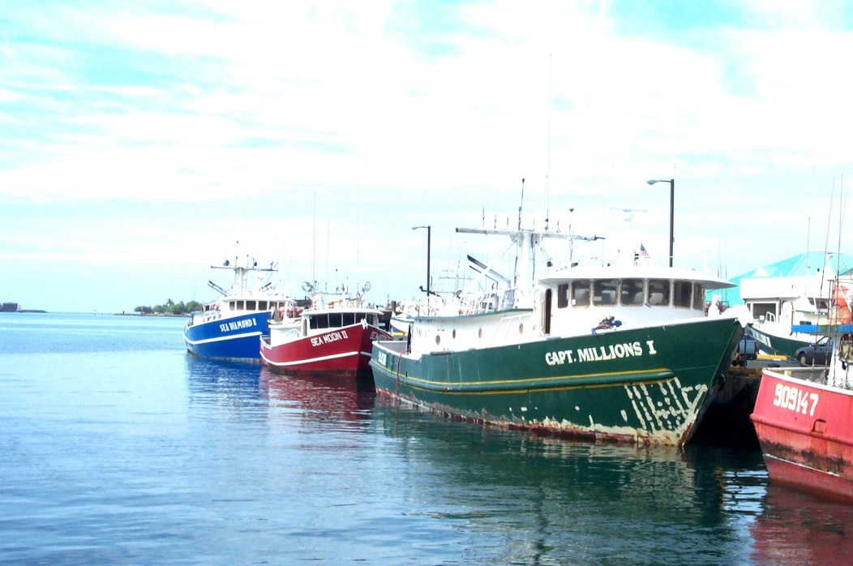
DISPROPORTIONATE BURDEN
US funds Pacific Island and East Asian Nations with $1.4B for Economic Development, including fisheries, yet these nations remain adversarial to US Pacific Island fishing interests.
Level the Playing Field!
Council-managed fisheries, including the HI longline fishery, do not enjoy any special privileges that are afforded to other island nations
HI LL fishery has the lowest catch limit for bigeye tuna
HI and AS fisheries are the international gold standard for monitoring and compliance
Competing foreign fisheries are heavily subsidized - China provides $7.3B in subsidies, 91-95% classified as “harmful”
The US Freely Associated States receive $262M in economic development annually
Notes:
Data from: https://explorer.usaid.gov/ or https://foreignassistance.gov/. Foreign aid, 2018: $1.6 billion from the United States to East Asia and Oceania, of which $1.4B is economic development: Of that, $271M comes from DOI; $687M from USAID; $248M from Dept of State; $92M from Dept of Ag.
Most AID for government and civil society, but, $89M for ‘General environmental protection’; $77M for developmental food aid and food security
Foreign Aid by US to East Asia and Oceania Fishing Nations – 2020 Obligations
PI: $322M FSM: $144M Indonesia $142M
RMI: $102M PNG: $16M Fiji: $5.6M
Vanuatu: $2.3M Palau: $15.8M W Samoa: $1.6M
Tonga: $2.8M China: $10.2M Malaysia: $13.7M
United States spends $21M per annum on South Pacific Tuna Treaty -- Access fees for purse seine fishing in Australia, Cook Islands, FSM, Fiji, Kiribati, RMI, Nauru, New Zealand, Niue, Palau, PNG, Samoa, Solomon Islands, Tonga, Tuvalu, US, Vanuatu (487 registered Pacific Purse Seiners, 15 that at US boats)
2,102 Longline Vessels in WCPFC, 150 active Hawaii and Am Sam longline vessels (HI capped at 160; AS capped at 60)
WHAT ARE WE DOING: Fisheries Development for our US Territories, Working on increasing the catch limits for our fisheries, we need to ensure that our territories maintain food security and are a part of the global tuna supply chain, including the cannery in AS., Joint ventures in CNMI and Guam with foreign operators- development of shark fishery for CNMI, connecting COFAS to territorial tax structure with fishing permits and reporting, working with the US military to ameliorate on the ground fisher user conflict issues, diversifying AS LL fisher opportunities to include albacore jigging/trolling

Slide 9
Biden Proclamation: Indigenous Peoples Day (10/8/21)
“The Federal Government has a solemn obligation to lift up and invest in the future of Indigenous people and empower Tribal Nations to govern their own communities and make their own decisions. ”
"You must make difficult decisions,
but if you make those decisions with the counsel and
advice from traditional practitioners and those who are most closely affected by, and connected to a particular resource or area, your decisions will be sound."
- Chief Justice William S. Richardson, Supreme Court Hawaii;
a local boy born in Honolulu who attended public high school,
University of Hawaii (Manoa) and University of Cincinnati College of Law
Notes:
Biden’s Proclamation for Indigenous People’s day
A better future demands the rebalancing of the fundamental relationship between the federal government and minority communities now. HOW?
Increased core investments coupled with tactical supports that together, can begin to address the drivers and barriers responsible for the longstanding disproportionate impacts region wide.
The Hawaiian Kingdom was overthrown on January 17, 1893.
What are things that the Councils could use – scholarship, staffing in different jurisdiction (territories/states/provinces)

